Slide 1




Frontiers of Uncertainty Quantification for EFTs
Dick Furnstahl
EMMI Hirschegg Meeting, January 2023
Slides: http://bit.ly/3vTc0IW
https://nuclei.mps.ohio-state.edu/
https://buqeye.github.io/
https://www.lenpic.org/
Jupyter notebooks here!
https://bandframework.github.io/
See also later talks and Frontiers in Physics volume on Uncertainty Quantification in Nuclear Physics
Notes:
Alternative for slides: https://tinyurl.com/56drrvud

Slide 2
Questions for the Hirschegg meeting
What are the limits of EFT for nuclei and for matter? What should be the priority developments and improvements for EFTs, including the exploration of alternative power counting schemes?
What are systems where more effective EFTs, such as pionless or halo EFT, are particularly promising? What are priorities for improving nuclear energy density functionals in the spirit of EFT?
What are the priorities for developments and applications in uncertainty quantification? What are new opportunities for nuclear structure from emerging technologies?
What should be EFT and many-body priorities in nuclear structure research in light of the advent of new experimental facilities for the study of exotic nuclei?
Uncertainty quantification (UQ) is explicitly called out in one of these questions, but (Bayesian) statistical analysis can play an important role in addressing all questions!
Frontier UQ topics: validation of models for truncation errors; limits of EFTs from statistical analysis; calibration of EFTs; accounting for and exploiting correlations; Bayesian model mixing; experimental design; development of emulators.

Slide 3
Checklist for statistically sound Bayesian inference for EFTs
Incorporate all sources of experimental and theoretical errors
Propagate errors through the calculation (e.g., LECs → observables)
Formulate statistical models for uncertainties (e.g., EFT truncation)
Use informative priors (e.g., EFT power counting)
Account for correlations in inputs (type x) and observables (type y)
Use model checking to validate our models (and EFTs)
Include oversight by experts (statisticians)
For publications and talks, see https://buqeye.github.io/
Jupyter notebooks also!
Bayesian updating of knowledge

Slide 4
Reminder about statistical correlations
pr(x, y| z) “joint probability (density) of x and y given z” (contingent on z)
marginalized
pr(x|z)
pr(y|z)
joint
y
pr(x,y|z)
X
y
Notes:
\mathcal{N}e^{-\frac12 \mathbf{r}^{\intercal}{\color{red}\Sigma^{-1}}\mathbf{r}}
&= \mathcal{N} e^{-\frac{(x-\mu)^2}{2\sigma_x^2}} e^{-\frac{(y-\mu)^2}{2\sigma_y^2}}
\\
\mathbf{r} = \begin{bmatrix} x \\ y \end{bmatrix} &
\qquad
{\color{red}\Sigma = \begin{bmatrix} \sigma_x^2 & 0 \\
0 & \sigma_y^2
\end{bmatrix}}
\mathcal{N}e^{-\frac12 \mathbf{r}^{\intercal}{\color{red}\Sigma^{-1}}\mathbf{r}}
&= \mbox{correlated gaussian}
% = \mathcal{N} e^{-\frac{(x-\mu)^2}{2\sigma^2}} e^{-\frac{(y-\mu)^2}{2\sigma^2}}
\\
\mathbf{r} = \begin{bmatrix} x \\ y \end{bmatrix}
\qquad &
{\color{red}\Sigma = \begin{bmatrix} \sigma_x^2 & \rho\sigma_x\sigma_y \\
\rho\sigma_x\sigma_y & \sigma_y^2
\end{bmatrix}}

Slide 5
Reminder about statistical correlations
pr(x, y| z) “joint probability (density) of x and y given z” (contingent on z)
marginalized
pr(x|z)
pr(y|z)
joint
y
With two, e.g., x and y, -1 ≤ ρ ≤ 1 → correlation. With many x₁, x₂, … x_{N}, all pairs have a ρ_{ij} correlation to be learned. A gaussian process parametrizes the ρ_{ij} (and σ_{i}) via hyperparameters.
pr(x,y|z)
X
y
Notes:
\mathcal{N}e^{-\frac12 \mathbf{r}^{\intercal}{\color{red}\Sigma^{-1}}\mathbf{r}}
&= \mathcal{N} e^{-\frac{(x-\mu)^2}{2\sigma_x^2}} e^{-\frac{(y-\mu)^2}{2\sigma_y^2}}
\\
\mathbf{r} = \begin{bmatrix} x \\ y \end{bmatrix} &
\qquad
{\color{red}\Sigma = \begin{bmatrix} \sigma_x^2 & 0 \\
0 & \sigma_y^2
\end{bmatrix}}
\mathcal{N}e^{-\frac12 \mathbf{r}^{\intercal}{\color{red}\Sigma^{-1}}\mathbf{r}}
&= \mbox{correlated gaussian}
% = \mathcal{N} e^{-\frac{(x-\mu)^2}{2\sigma^2}} e^{-\frac{(y-\mu)^2}{2\sigma^2}}
\\
\mathbf{r} = \begin{bmatrix} x \\ y \end{bmatrix}
\qquad &
{\color{red}\Sigma = \begin{bmatrix} \sigma_x^2 & \rho\sigma_x\sigma_y \\
\rho\sigma_x\sigma_y & \sigma_y^2
\end{bmatrix}}

Slide 6
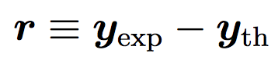
Two ways to treat theory model discrepancy
Statistical model for observable y:
Advice from statisticians: any model for theory discrepancy is better than no model!
1. Model the distribution of residuals:
(δy_{exp})_{n} is often a Gaussian with mean μ = 0 and variance σ_{n}² → error bars of size σ_{n}
For δy_{th}, look at pattern of residuals and learn it (train and test; correlated → GP).
2. For EFTs, can learn from convergence pattern (cutoff dependence?)
Expect that each order will roughly improve by expansion parameter Q < 1:
Treat the c_{n}s as random variables and learn their distribution from calculated orders
Theory at order k:
Omitted orders:
Notes:
For 1., can use machine learning. Neural network, for example, or just a GP.
Informed is better than uninformed, but anything better than nothing.
Model discrepancy (“All models are wrong, but some are useful” – George Box)
Incomplete or in parts incorrect physical model
Effective field theory expansion truncation error

Slide 7
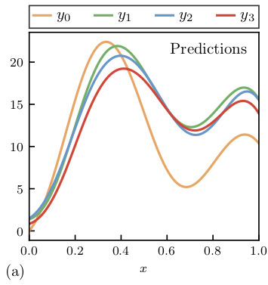
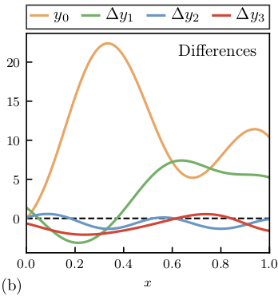
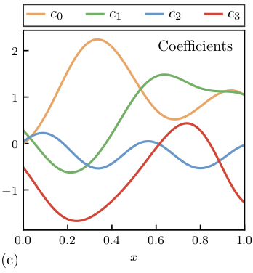
Coefficients for a Bayesian EFT truncation model (not LECs!)
x can be continuous (e.g., energy, angle, density,) or discrete (e.g., nuclear level).
[dimensionless]
Either case can be correlated!
Order-by-order predictions of y:
Focus on differences: → rescale by reference and Q^{n} :
Treat c_{n}s (not LECs!!) as random variables and learn from calculated orders
→
Assumption: behavior of c_{n}s persists across orders with characteristic size c (natural)
Notes:
Just a repametrization of the order-by-order calculations!
\newcommand{\yvec}{y}
\yvec_{\rm th}(x) = \yvec_{0} + \yvec_{1} + \cdots + \yvec_{k}
{\rm EFT} \Rightarrow Q = \frac{\{p,m_{\rm low}\}}{\Lambda_b}, \quad \Lambda_b \Rightarrow \text{breakdown}
\chi{\rm EFT} \Rightarrow Q = \frac{\{p,m_\pi\}}{\Lambda_b}, \quad \Lambda_b \approx 600\,{\rm MeV}

Slide 8
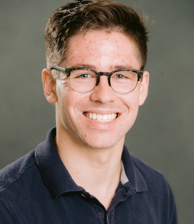
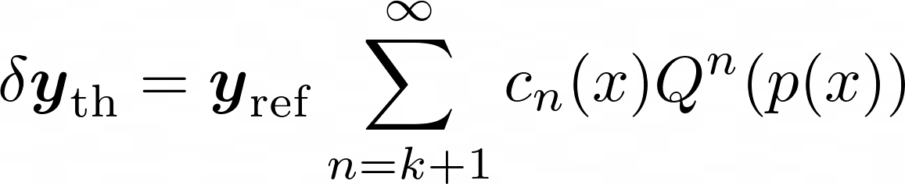
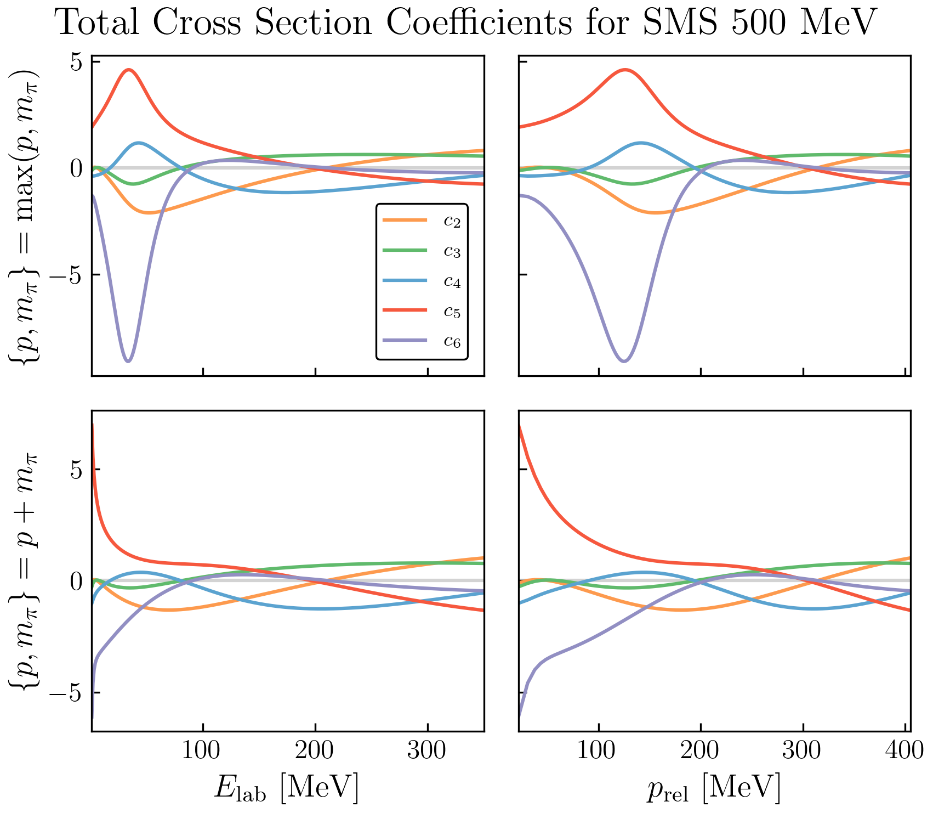
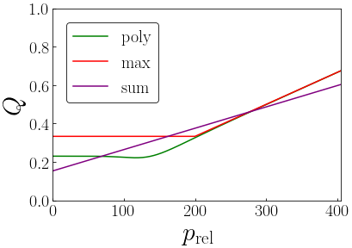
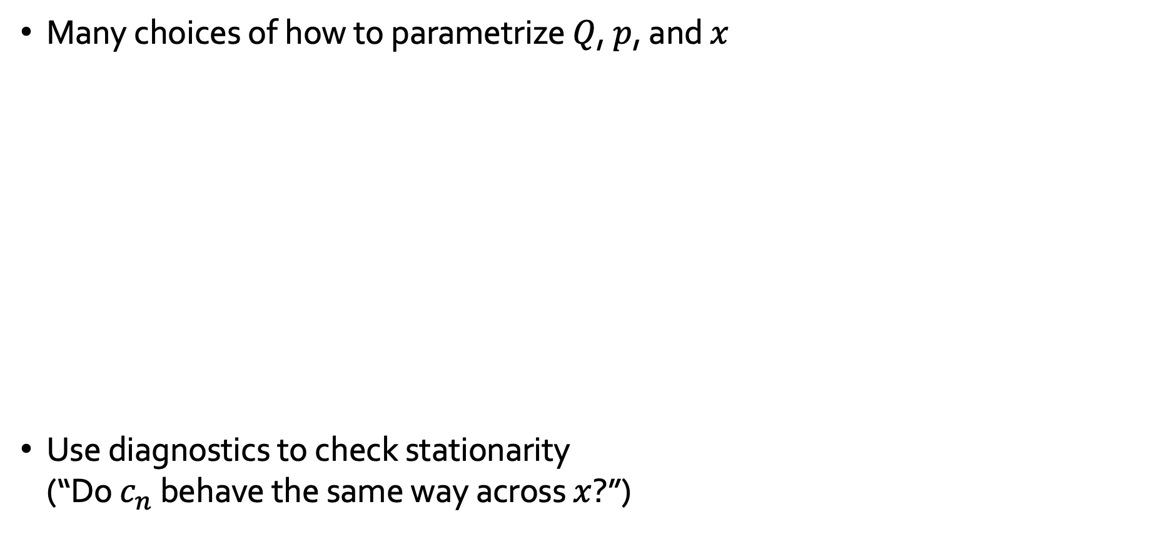
Choices of parametrization
From P. Millican et al., Effective Field Theory Convergence Pattern of Modern Nucleon-Nucleon Potentials (in prep., 2023)
Many choices of how to parametrize $Q$, $p$, and $x$
Use diagnostics to check stationarity (“Do $c_{n}$ behave the same way across $x$?”)
dimensionless expansion parameter
characteristic momentum
input space

Slide 9
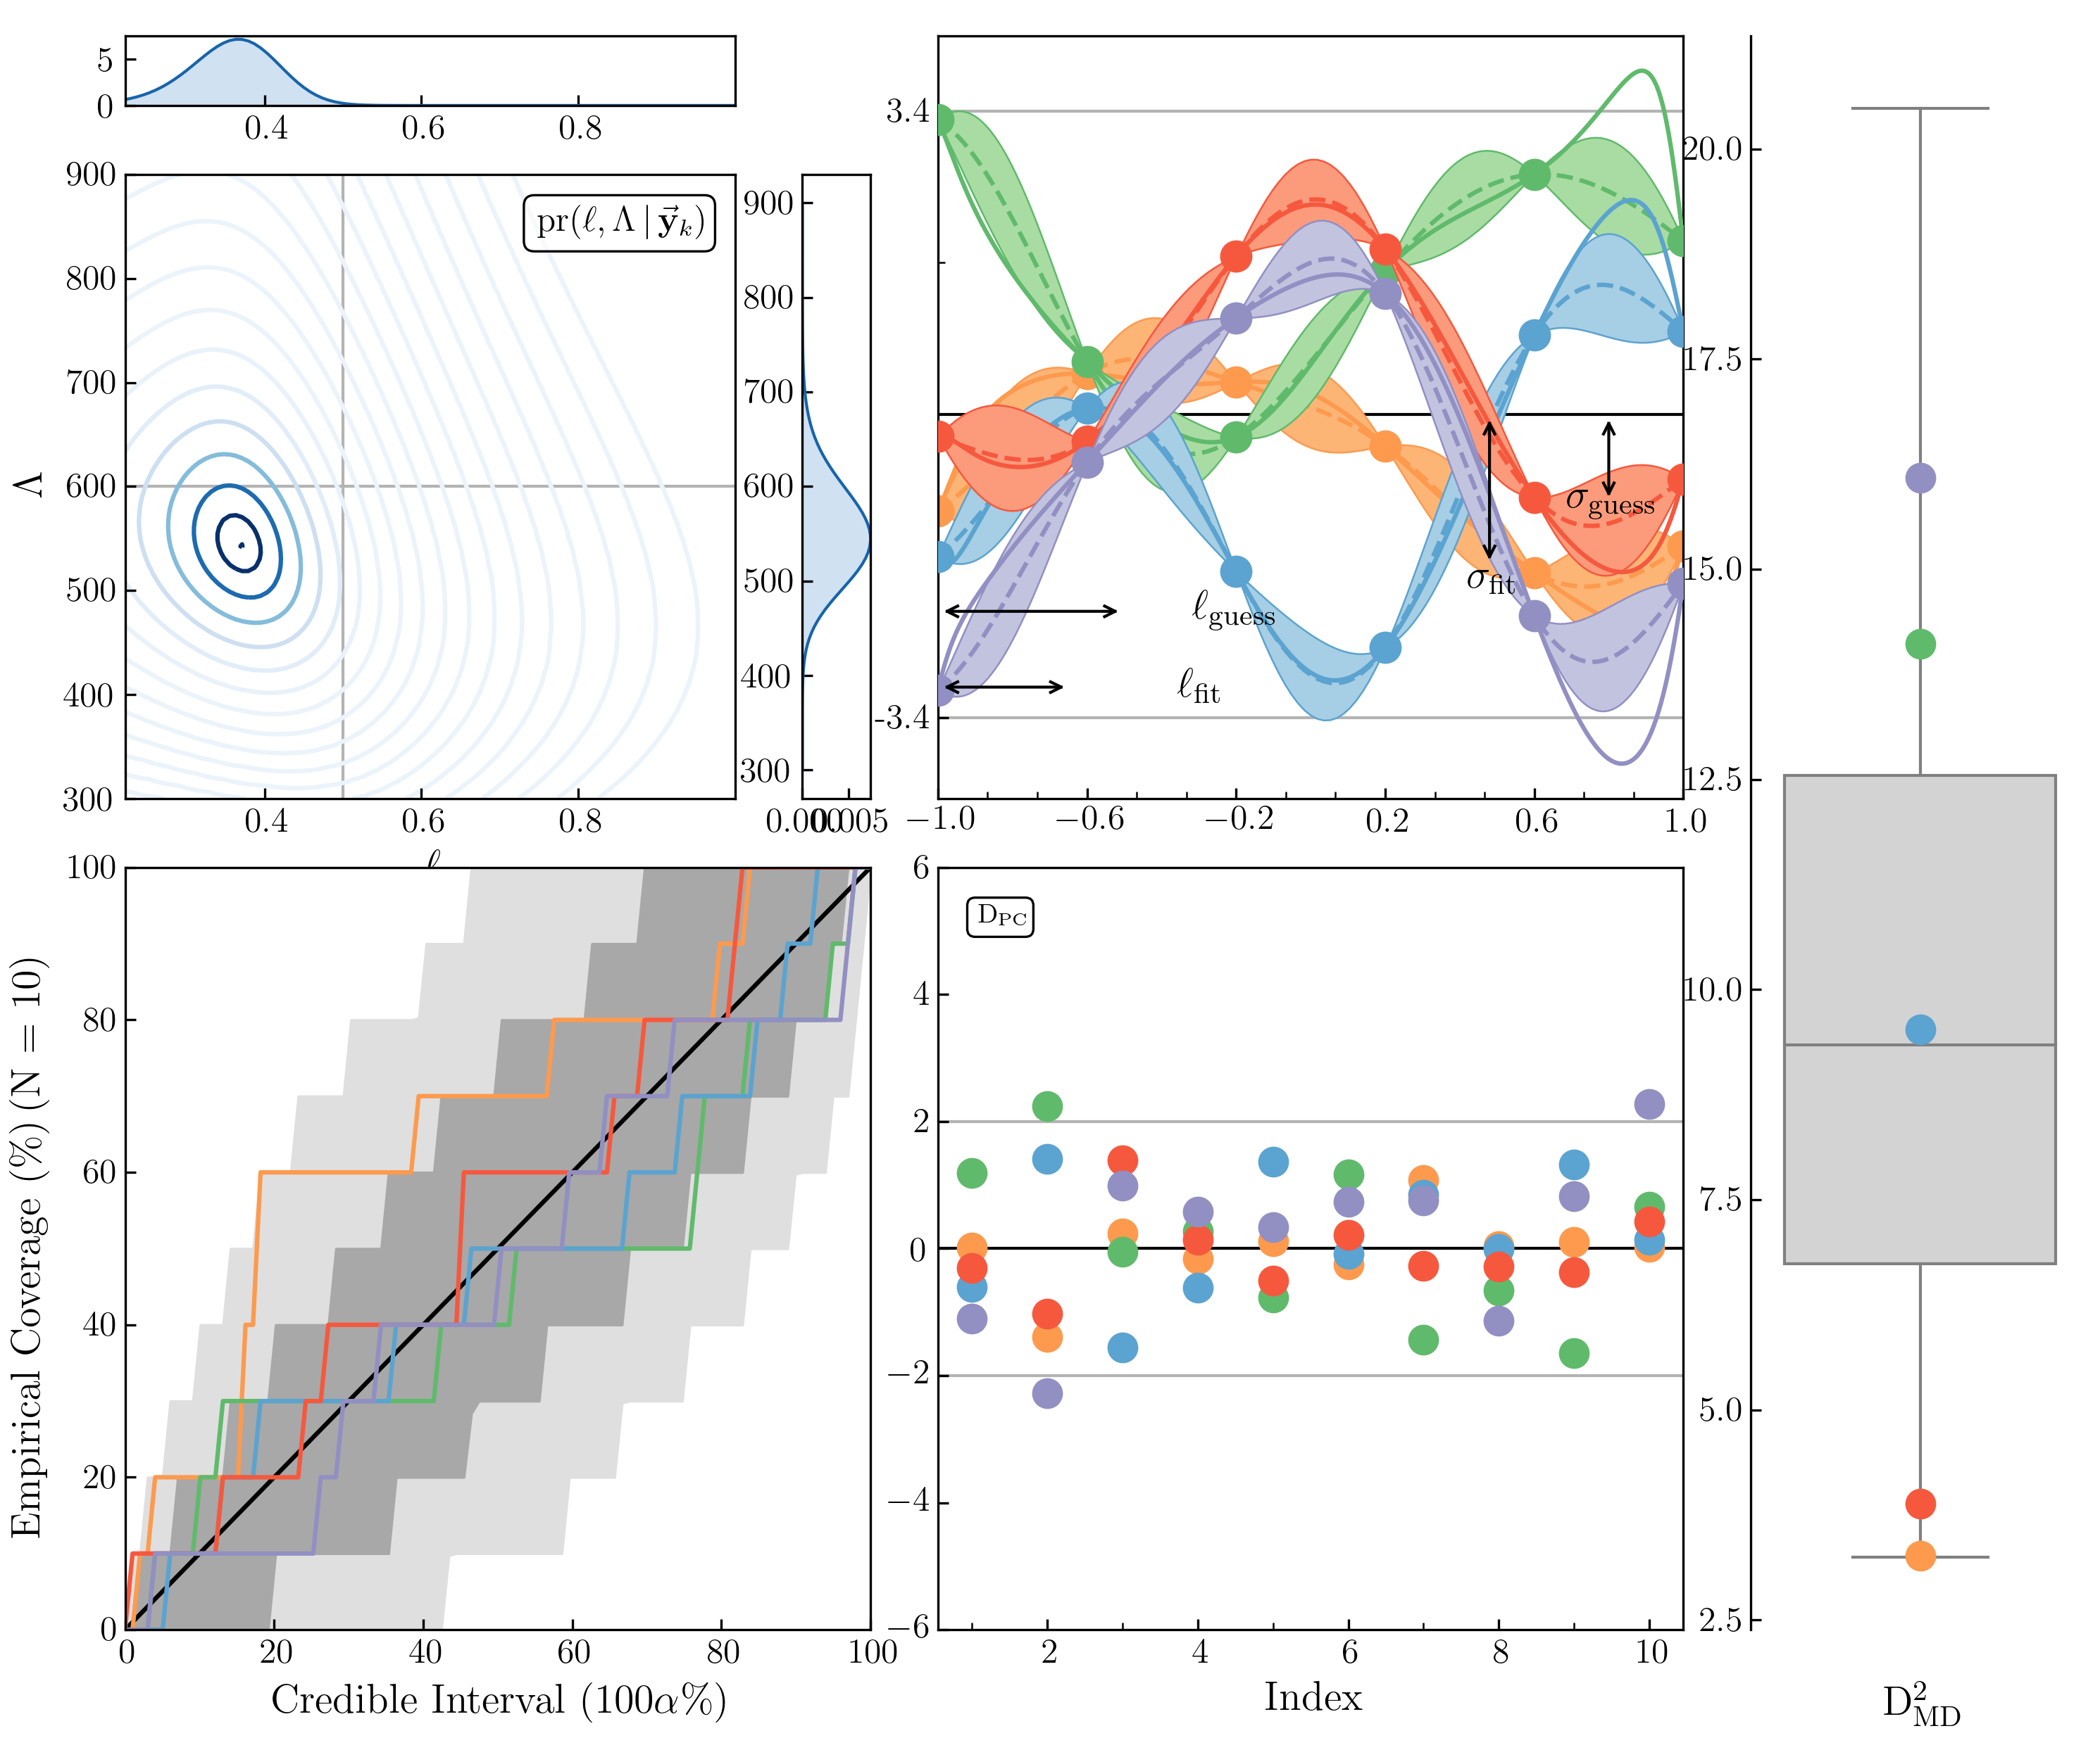
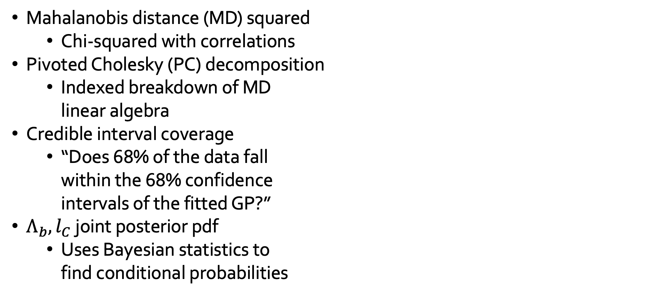
Statistical diagnostics [Melendez et al. (2019) and Millican et al. (2023]
Mahalanobis distance (MD) squared
Chi-squared with correlations
Pivoted Cholesky (PC) decomposition
Indexed breakdown of MD linear algebra
Credible interval coverage
“Does 68% of the data fall within the 68% confidence intervals of the fitted GP?”
$Λ_{b},l_{C}$ joint posterior pdf
Uses Bayesian statistics to find conditional probabilities
Spin observable D (150 MeV) for SMS 450 MeV potential
Notes:
D (150 MeV) SMS 450 MeV
Qsum, Qofprel, cos

Slide 10
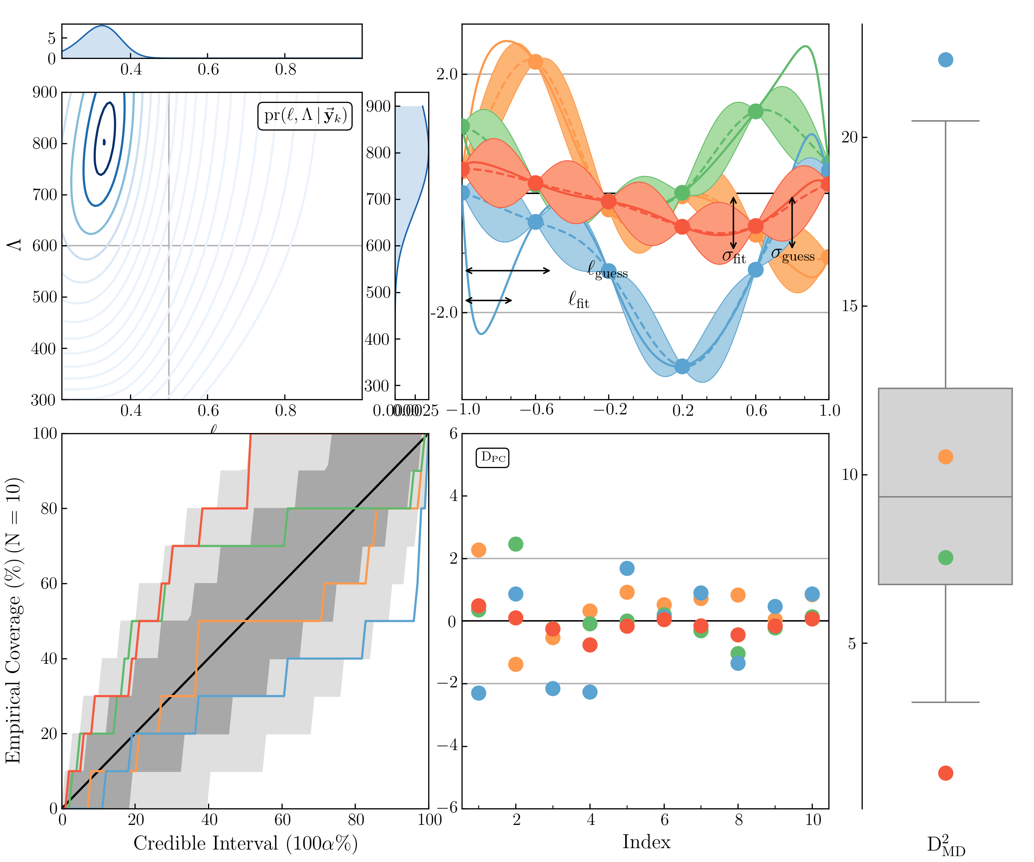
Statistical diagnostics [Melendez et al. (2019) and Millican et al. (2023]
Mahalanobis distance (MD) squared
Chi-squared with correlations
Pivoted Cholesky (PC) decomposition
Indexed breakdown of MD linear algebra
Credible interval coverage
“Does 68% of the data fall within the 68% confidence intervals of the fitted GP?”
$Λ_{b},l_{C}$ joint posterior pdf
Uses Bayesian statistics to find conditional probabilities
Spin observable D (150 MeV) for SCS 1.2 fm potential
Notes:
D (150 MeV) SMS 450 MeV
Qsum, Qofprel, cos

Slide 11
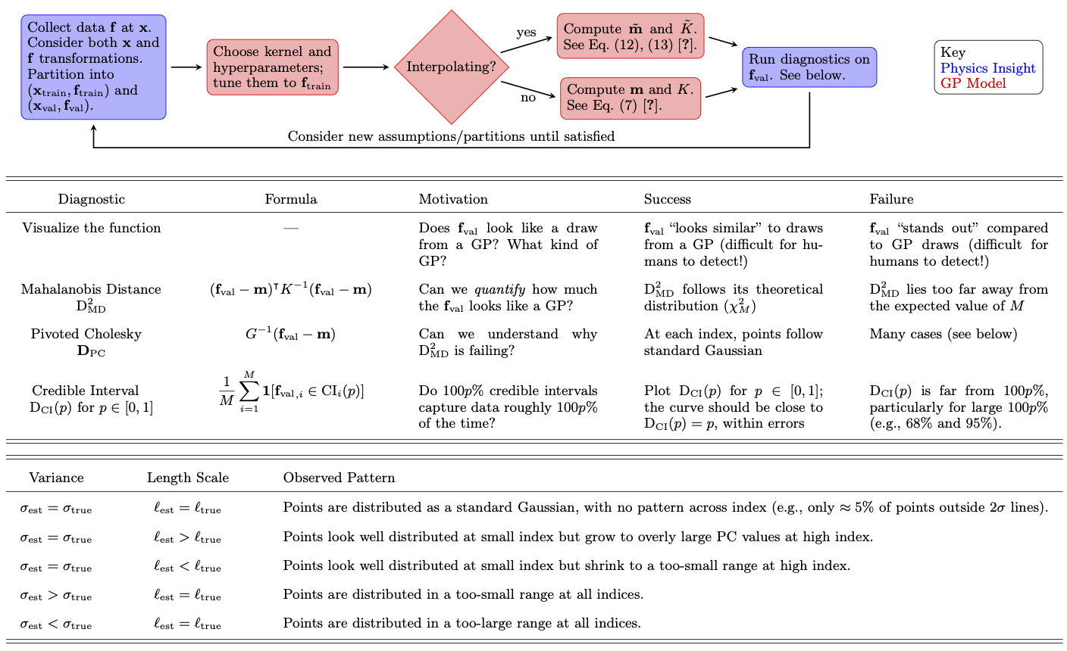
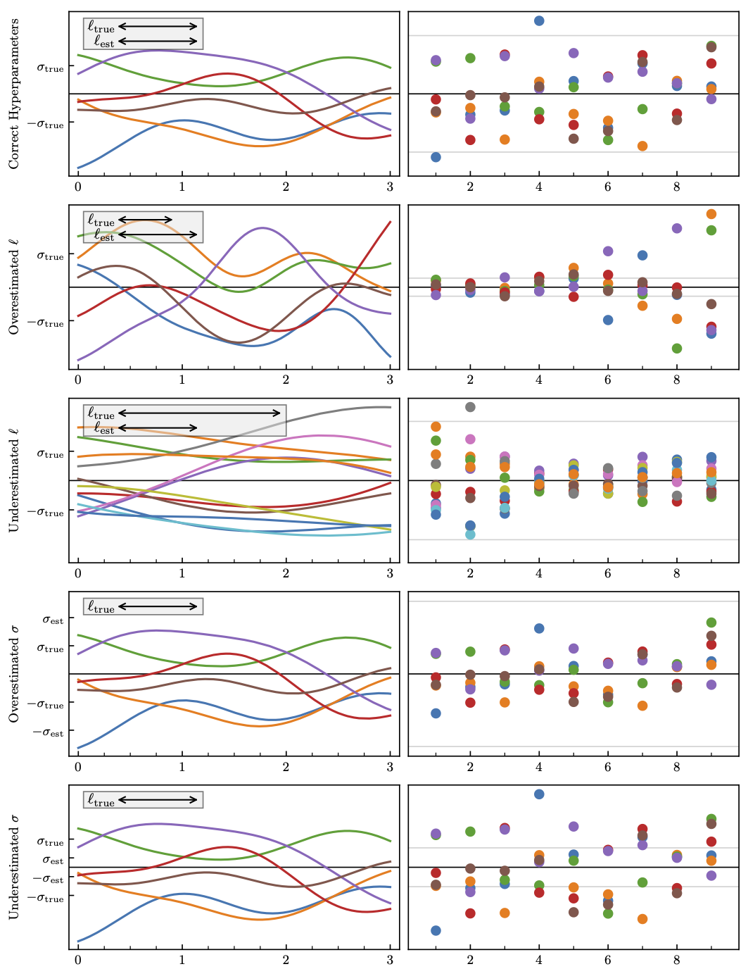
Workflow

Slide 12
Rigorous constraints on three-nucleon forces in chiral effective field theory from fast and accurate calculations of few-body observables
Wesolowski, Svensson, Ekström, Forssén, rjf, Melendez, and Phillips, arXiv:2104.04441 PRC 104, 064001 (2021)
BUQEYE Collaboration
See also: Djärv et al., PRC (2022) on A=6 nuclei, Svensson et al., arXiv:2206.08250 on Bayesian LEC estimation; Alnamlah et al., Front. Phys. (2022) on EFT for rotational bands; Acharya et al. Front. Phys. (2022) on E&M observables; Poudel et al., J. Phys. G (2022) on 3He-α scattering; Baker et al., PRC (2022) on N-A, …
Notebook with all figures at
https://buqeye.github.io
Original title: Fast & rigorous constraints on chiral three-nucleon forces from few-body observables
Chiral 3N forces: estimate constraints on c_{D} and c_{E}
Few-body observables (cf. other possibilities): ³H ground-state energy; ³H β-decay half-life; ⁴He ground-state energy; ⁴He charge radius
c_{E}
c_{D}
Rigorous: statistical best practices for parameter estimation
Fast: uses eigenvector continuation emulators for observables
Notes:
Sarah Wesolowski, Isak Svensson

Slide 13
(almost) Full Bayesian approach to constraining parameters
Experimental data
Other info (EFT scheme/scale, etc.)
NN and 3N LECs
Truncation error variance
EFT expansion parameter
Individual posteriors; everything has priors!
All experiment and theory errors
Likelihood:
Uses NNLO chiral EFT without Δ’s based on Carlsson et al. PRX 6, 011019 (2016), but methods are general (other regulators, Δ’s, other observables)
Sample pdf with MCMC over 15 dimensions (11 NN LECs + c_{D}, c_{E} + Q, c²) → marginalize (integrate out) what you are not considering

Slide 14
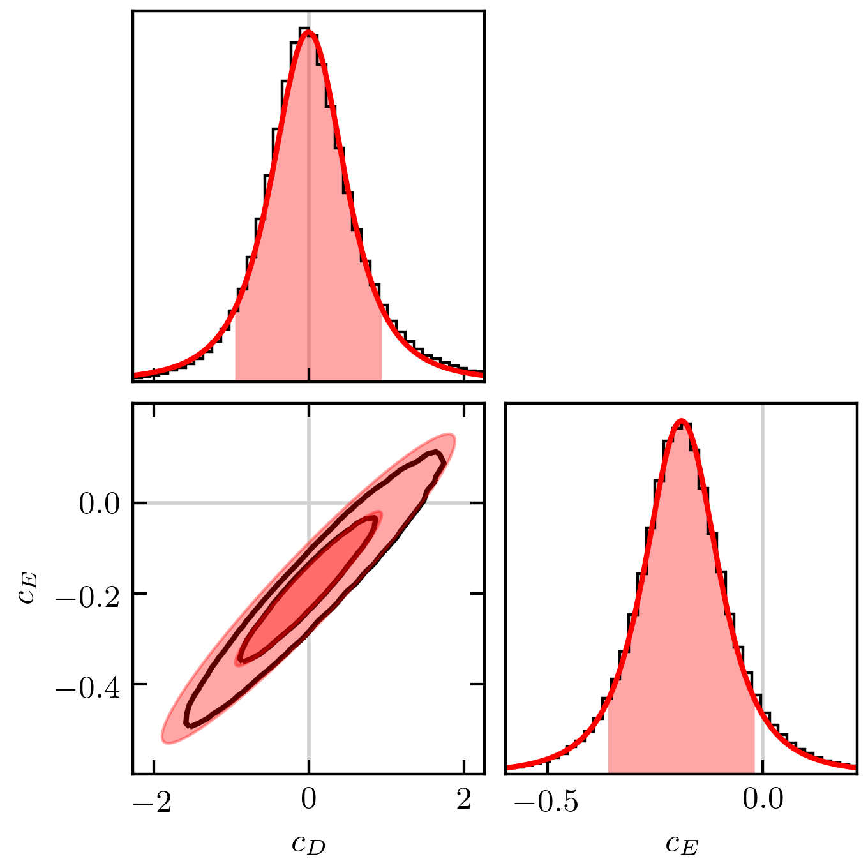
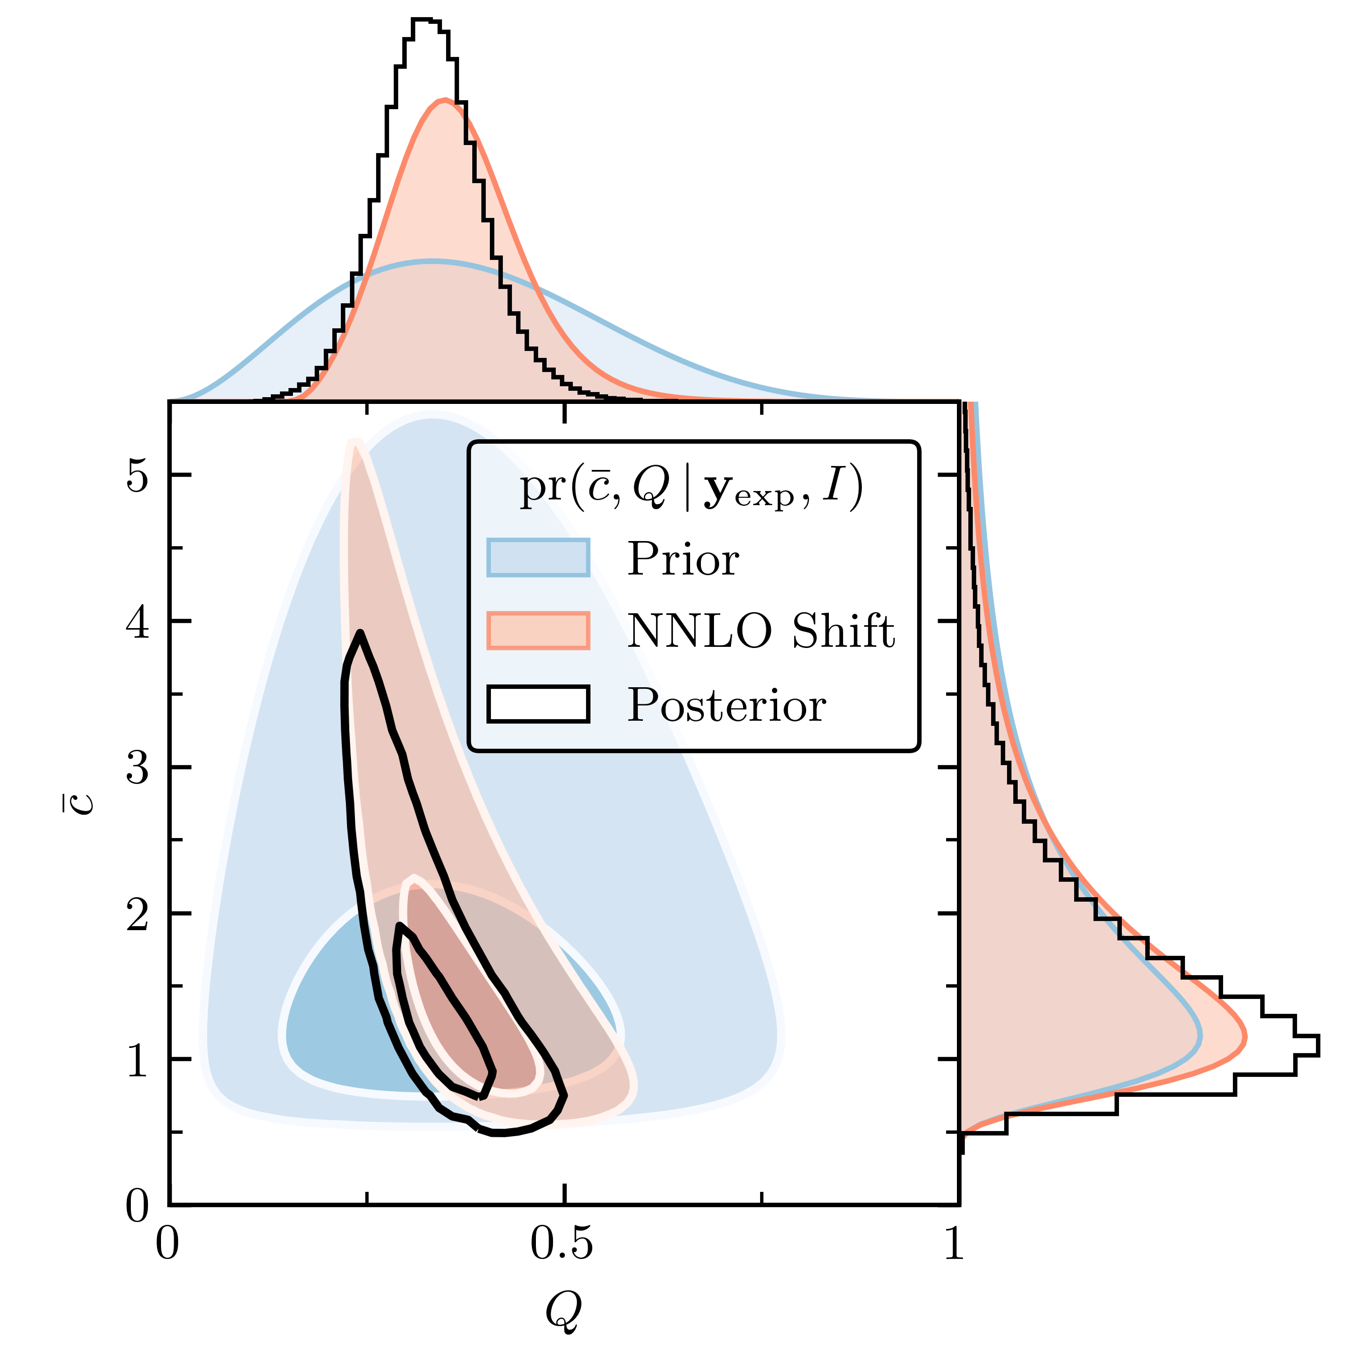
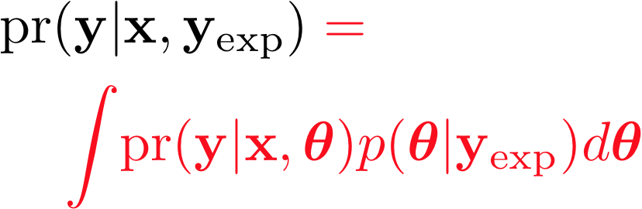
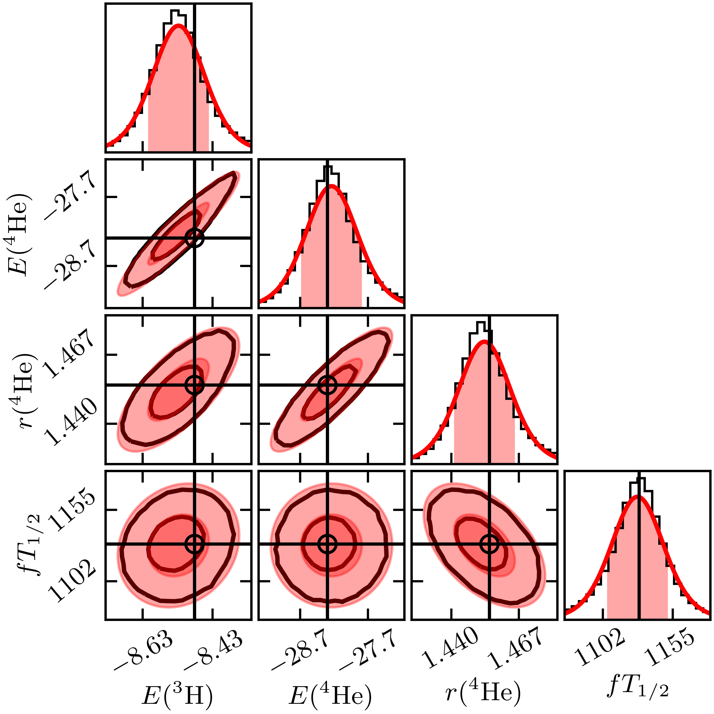
Posteriors from “Fast & Rigorous” [PRC 104, 064001 (2021)]
Posterior for c_{D} and c_{E}
Posterior for Q and c
Posterior predictive distribution
Correlation of ρ ≈ 0.96 for this χEFT Hamiltonian
Statistically consistent!
Tails are not well approximated by a Gaussian! (But do look like t’s!)
Truncation error for observables:
Sample pdf with MCMC over 11 NN LECs + c_{D}, c_{E} + Q, c² → marginalize (integrate out) what you are not considering
Notes:
Two mistakes in using results in first graph by the peak and sd treated as Gaussian: you miss the correlation and you miss the tails – not a Gaussian but essentially a Student t distribution.
Emphasize that these are specific results, but it is a *framework* available to all through Jupyter notebooks.
For PPD, statistically consistent *only* if the truncation error is included.
&{\color{black}\pr(\mathbf{y}|\mathbf{x},\mathbf{y}_{\rm exp})} = \\ & \quad\int\! \pr(\mathbf{y}|\mathbf{x},\bm{\theta}) p(\bm{\theta}|\mathbf{y}_{\rm exp}) d\bm{\theta}
The distribution for Q peaks at about 1/3 with a 20% uncertainty.
This is consistent with χEFT considerations for few-body observables [(m_{π})^{eff}/Λ_{b}] and with other estimations (cf. LENPIC papers).
This is what the data prefer for the size of the N³LO uncertainty.
Propagate errors from pdf for LECs learned from data to the observables.
Analysis is statistically consistent (experimental data are black circles) as long as truncation errors included.
Some observables are highly correlated; some are not.

Slide 15
Light nuclei with semilocal momentum-space regularized chiral interactions up to [and beyond] N²LO
LENPIC Collaboration
P. Maris et al., PRC 103, 054001 (2021)
arXiv:2104.04441
P. Maris, R. Roth et al., PRC 106, 064002 (2022)
arXiv:2206.13303
https://www.lenpic.org/
Consistent NN and 3N potentials to N²LO [2022: NN to N⁴LO]
“Semilocal” to reduce regulator artifacts
c_{E} and c_{D} from ³H binding and Nd diff. cross section minimum
Calculations for few-body and p-shell+ nuclei (NCCI plus SRG)
Bayesian estimates of EFT truncation errors (also method error)
Many results (e.g., overbinding at N²LO and cutoff dependence reduced with higher-order NN; but radii still underpredicted).
c_{E}
c_{D}
Notes:
“Consistent” in multiple senses here: Evgeny will say more

Slide 16
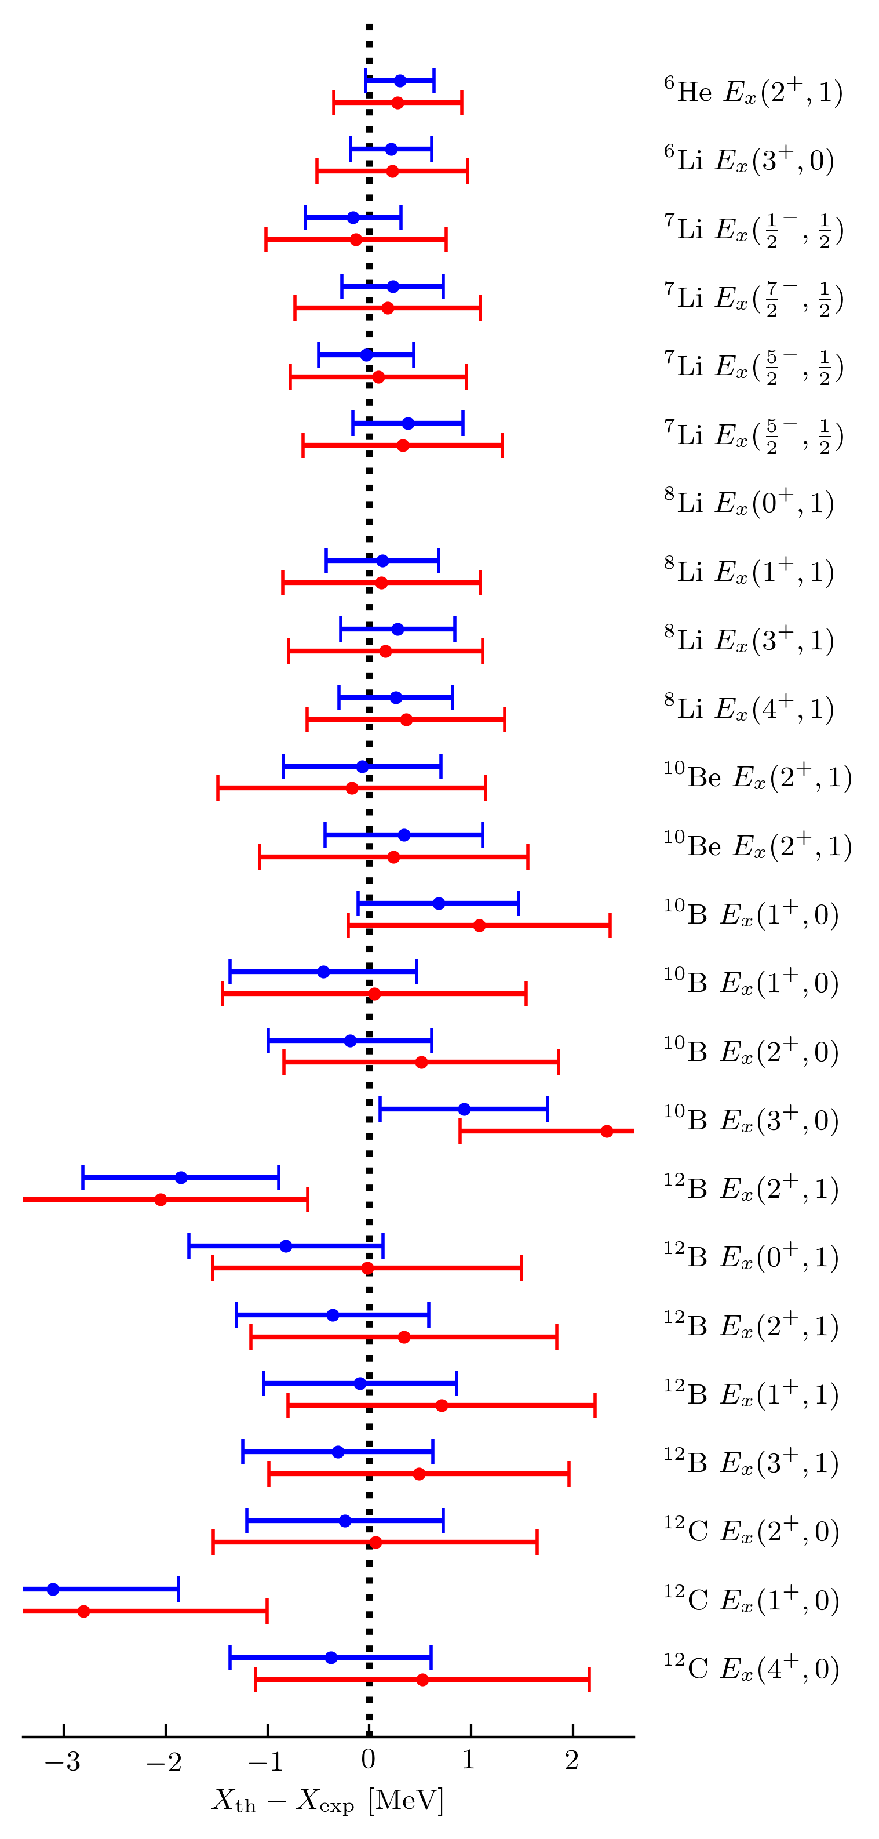
Excitation energies are highly correlated
Theory minus experiment for selected excitation energies
Empirically: calculated excitation energies are better determined than each level.
Why? If E₁ and E₂ have δy_{th} variance σ², then E₂ – E₁ has 2σ² if uncorrelated but 2(1-ρ)σ² if correlated with ρ!
Plan: learn ρ from y_{th} coefficients c_{n}:
Bayesian 95% intervals for two cutoffs (blue & red)
Model checking: empirical coverage in agreement with experiment if correlations used for errors.
Diagnostic of physics: exceptions in ¹²C and ¹²B point to different theoretical correlations in the nuclear structure.
Higher order: >N²LO enables better estimates of correlations → more insight
Check if ≈95% of bars overlap zero
Coefficients for all the levels
Notes:
Use c3 to learn Q.
Use c2,c3 to learn rho.
Better estimates of correlations and Q.
Look for other opportunities to exploit correlations for physics in other nuclei!

Slide 17
Excitation energies are highly correlated
Theory minus experiment for selected excitation energies
Empirically: calculated excitation energies are better determined than each level.
Why? If E₁ and E₂ have δy_{th} variance σ², then E₂ – E₁ has 2σ² if uncorrelated but 2(1-ρ)σ² if correlated with ρ!
Plan: learn ρ from y_{th} coefficients c_{n}:
Bayesian 95% intervals for two cutoffs (blue & red)
Model checking: empirical coverage in agreement with experiment if correlations used for errors.
Diagnostic of physics: exceptions in ¹²C and ¹²B point to different theoretical correlations in the nuclear structure.
Higher order: >N²LO enables better estimates of correlations → more insight
Check if ≈95% of bars overlap zero
Notes:
Use c3 to learn Q.
Use c2,c3 to learn rho.
Better estimates of correlations and Q.
Look for other opportunities to exploit correlations for physics in other nuclei!

Slide 18
More correlations . . .
UQ for infinite matter [see C. Forssén talk]
Truncation-error correlations between different densities and observables is crucial for reliable UQ!
C. Drischler et al., Quantifying uncertainties and correlations in the nuclear-matter equation of state
W.G. Jiang et al., Emulating ab initio computations of infinite nucleonic matter and Emergence of nuclear saturation within Δ-full chiral effective field theory
Model space extrapolations: correlations between observables (machine learning?)
cf., Sun et al., How to renormalize coupled cluster theory, PRC 106 (2022)
UV better IR worse
IR better UV worse
⁶He vs. ⁴He
⁶He vs. ⁴He
Notes:
Sources of correlations in observables from EFT perspective: common operator.
Look for this (could be by machine learning!)
Maybe a teaser of correlations with model spaces with a couple of graphs
* IR is particular to a given nucleus
* UV is common to all nuclei, like operator product expansion

Slide 19
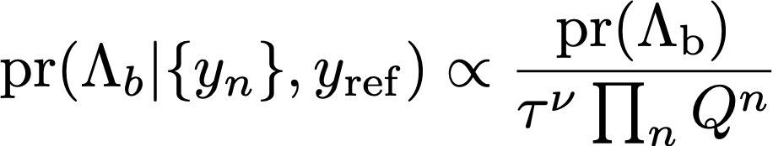
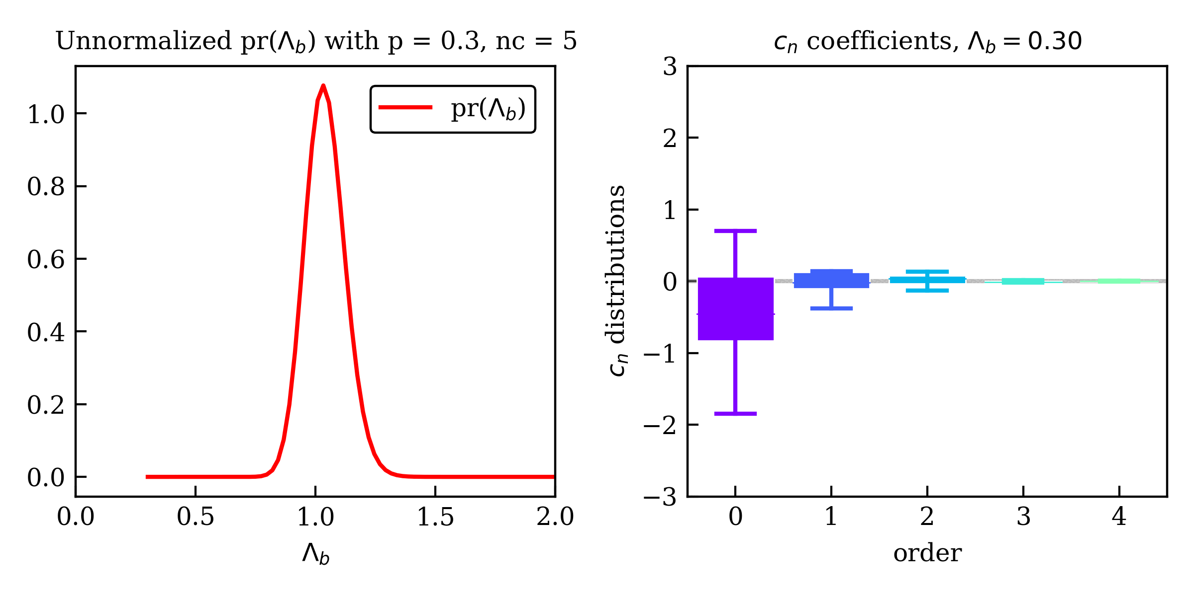
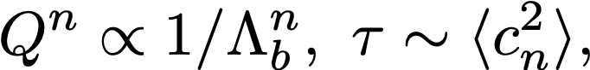
Limits of EFTs: Learning the expansion parameter
Melendez et al. (2019):
Model:
Expectation:
With the posterior favors Λ_{b} with same c_{n} variance for all n
Notes:
Consistent with mpi^{eff}/\Lambda_b
Other ways to determine limits? RG? Lepage plots (residuals with experiment as opposed to internal)
{\rm pr}(\Lambda_b | \{y_n\}, y_{\rm ref}) \propto \frac{\rm pr(\Lambda_b)}{\tau^{\nu}\prod_n Q^n}

Slide 20
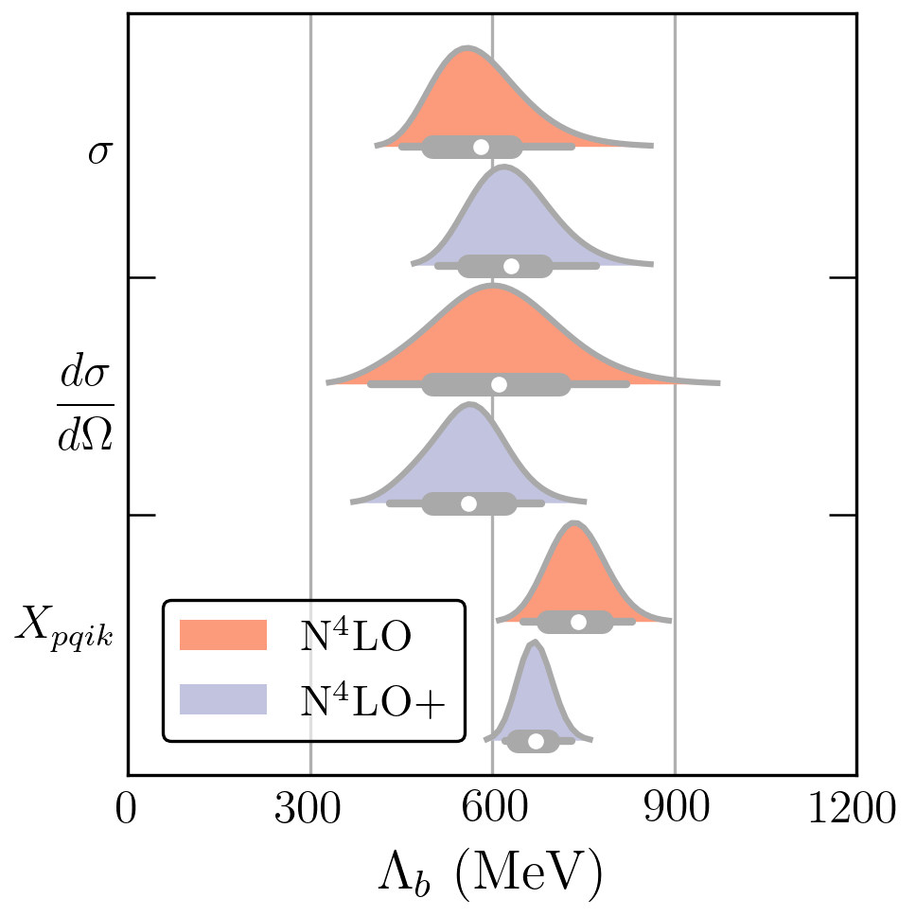
Limits of EFTs: Learning the expansion parameter
Melendez et al. (2019):
Model:
Expectation:
Λ_{b} from NN observables
Λ_{b} from infinite matter
With the posterior favors Λ_{b} with same c_{n} variance for all n
Millican et al., in prep [also Melendez et al., PRC (2017) and PRC (2019).]
SMS 450 MeV
Are different Λ_{b} posteriors consistent? Other ways?
How do correlations affect the estimation of the breakdown scale?
…
Drischler et al., PRC (2020)
Notes:
Consistent with mpi^{eff}/\Lambda_b
Other ways to determine limits? RG? Lepage plots (residuals with experiment as opposed to internal)
{\rm pr}(\Lambda_b | \{y_n\}, y_{\rm ref}) \propto \frac{\rm pr(\Lambda_b)}{\tau^{\nu}\prod_n Q^n}

Slide 21
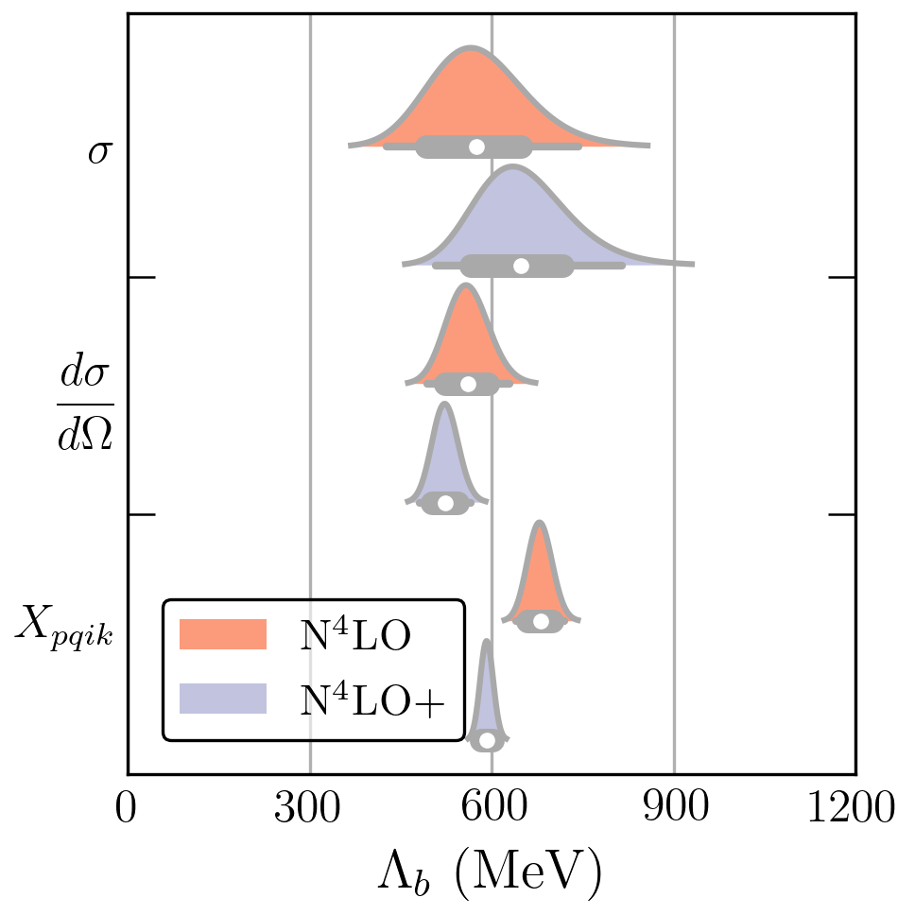
Limits of EFTs: Learning the expansion parameter
Melendez et al. (2019):
Model:
Expectation:
Λ_{b} from NN observables
Λ_{b} from infinite matter
With the posterior favors Λ_{b} with same c_{n} variance for all n
Millican et al., in prep [also Melendez et al., PRC (2017) and PRC (2019).]
SMS 450 MeV
Are different Λ_{b} posteriors consistent? Other ways?
How do correlations affect the estimation of the breakdown scale?
…
Drischler et al., PRC (2020)
Notes:
Consistent with mpi^{eff}/\Lambda_b
Other ways to determine limits? RG? Lepage plots (residuals with experiment as opposed to internal)
{\rm pr}(\Lambda_b | \{y_n\}, y_{\rm ref}) \propto \frac{\rm pr(\Lambda_b)}{\tau^{\nu}\prod_n Q^n}

Slide 22
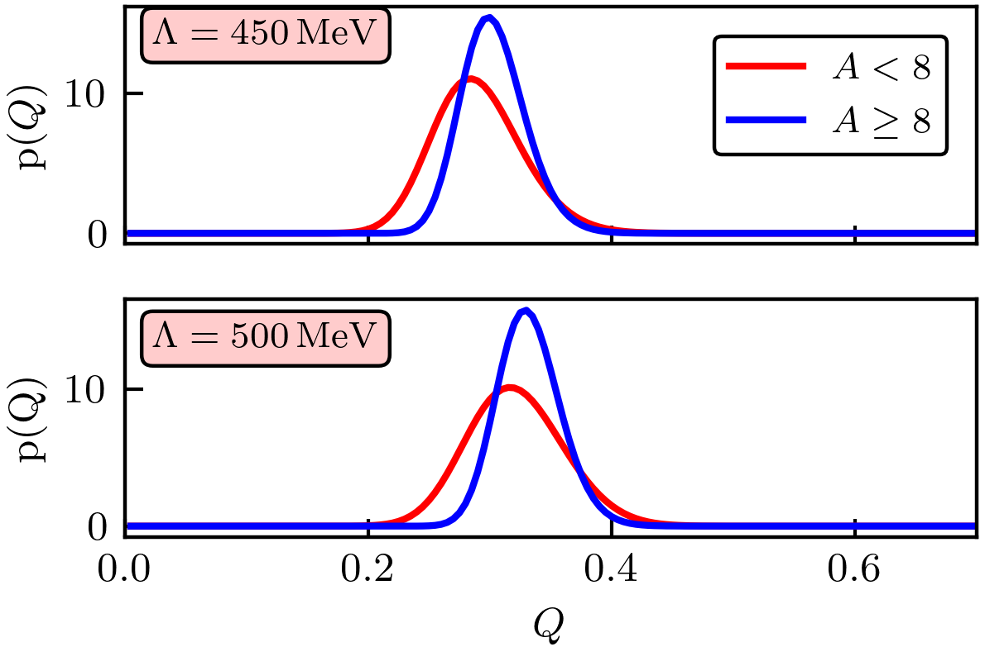
Limits of EFTs: Learning the expansion parameter
What about spectra of light nuclei? Convergence pattern obscured at low order by KE vs. PE cancellation. → only use higher orders → Q ≈ 0.3 [consistent with (m_{π})^{eff.}/Λ_{b} (see Ref.) ]
Model:
Expectation:
Q from few-body observables
Q from nuclear energies (A < 8 vs. A ≥ 8)
Wesolowski et al., PRC (2021)
Maris, Roth et al., PRC (2022)
Notes:
Consistent with mpi^{eff}/\Lambda_b

Slide 23
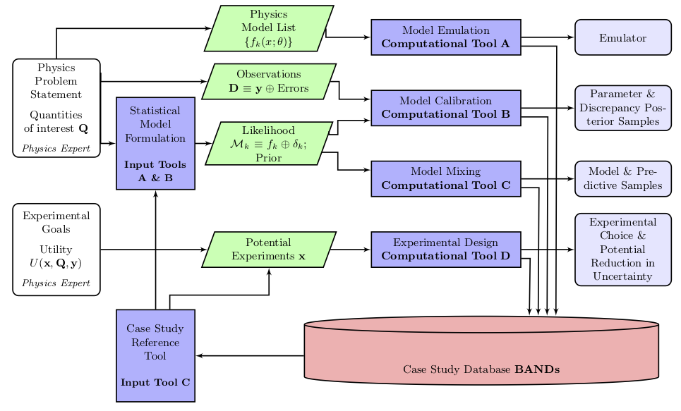
BAND (Bayesian Analysis of Nuclear Dynamics)
An NSF Cyberinfrastructure for Sustained Scientific Innovation (CSSI) Framework (started 7/2020)
Look to https://bandframework.github.io/ for manifeso and developments!
Model-mixing examples: Semposki et al., PRC (2022); Yannotty et al, 2301.02296. Matching expansions of a toy model at small and large coupling; different BMMs. Future: mixing nuclear EOS across ρ; mixing pionless + chiral EFT; …

Slide 24
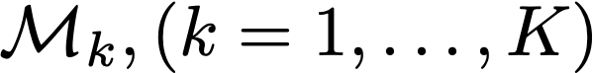
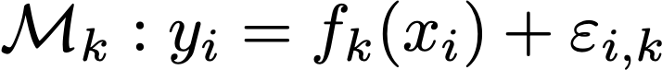
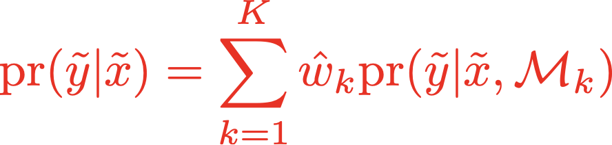
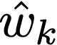
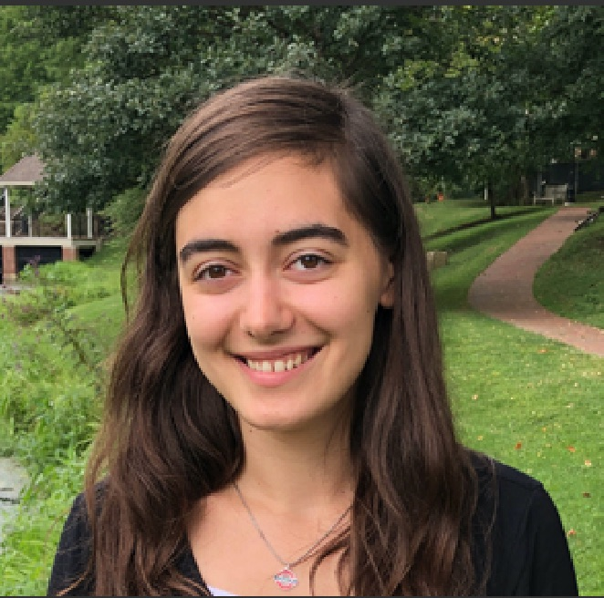
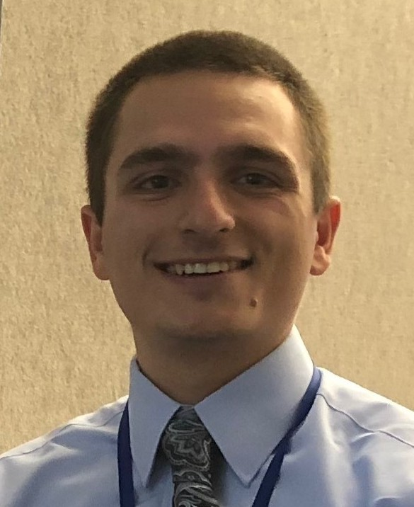
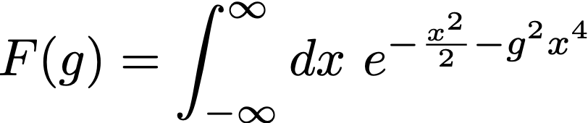
Toy Bayesian model mixing (BMM) example
Semposki et al., PRC (2022);
General: K models
Specify a model by predictions for observations y_{i} at points x_{i} →
Predictions at new input points:
Bayesian Model Averaging (BMA) has constant weights ; for BMM they depend on x_{i}.
Test strategies with expansions of:
and truncation error models.
A. Semposki
J. Yanotty
Notes:
Compare weighting for BMA by evidence vs. model mixing strategies (stacking, BART, others)
\mathcal{M}_k, (k=1,\ldots, K)
\mathcal{M}_k : y_i = f_k(x_i) + \varepsilon_{i,k}
{\rm pr}(\tilde y | \tilde x) = \sum_{k=1}^{K} \hat w_k {\rm pr}(\tilde y | \tilde x, \mathcal{M} _k)
F(g) = \int_{-\infty}^{\infty} dx~ e^{-\frac{x^{2}}{2} - g^{2} x^{4}}

Slide 25
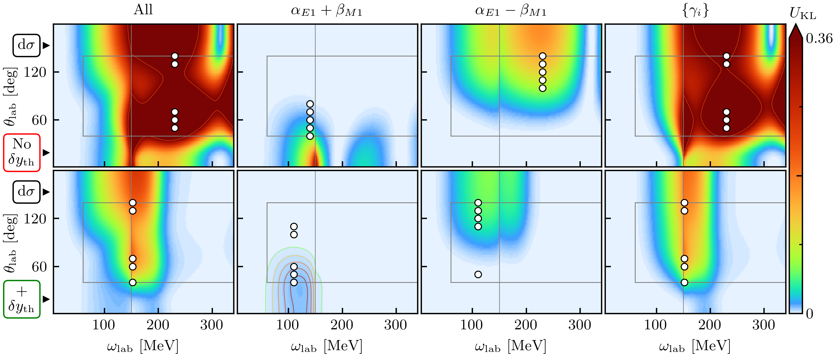
Experimental design: Future Compton scattering experiments
How to plan effective experiments & test theory? What (ω, 𝜃) are most useful for constraining?
Given: (1) Present polarizability error bars; (2) χEFT accuracy decreases as ω↑; (3) experimental constraints.
J. Melendez et al. (2021)
Compare utility with and without truncation error included ⇒ very different implications!
Notes:
The expected utility eq. (23) of proton differential cross section (dσ) measurements. Colors indicate the utility of one measurement conducted at each kinematic point (ωlab, θlab), with the point of largest utility UKL being by definition the optimal 1-point design. (The color bar is on a linear scale, though the hue varies much more quickly for small UKL.) The top row (with the red, “No δyth” box) does not include EFT truncation estimates, whereas the bottom row does include the EFT uncertainty. Each column shows the utility one could expect to achieve for a subset of the proton polarizabilities: the first column considers all polarizabilities together, while the second and third show the gain for αE1 ± βM 1 individually, and the final column reflects the collective information to be learned about the four spin polarizabilities {γi}. The interior box that excludes ω < 60 MeV along with forward and backward angles marks the experimentally accessible regime (see text for further discussion). The vertical line marks the cusp at the pion-production threshold. To visualize the full range of variation in the subplots, the color ranges from zero to a saturation point calculated by averaging the optimal utilities across all subplots. Contour lines are added for utilities above the saturation point, with the first contour at saturation and subsequent contour lines at intervals of 50% of the color range, see the top left subplot. To help visualize the utilities from less-constraining measurements, additional contours are added to any subplot whose maximum utility is less than 10% of the color range, see, e.g., fig. 6. Unless otherwise stated, the color ranges are common to all subplots within a figure, but different between figures. The white circles with black borders show the optimal five-point design kinematics, as described in the text. The effect of including EFT truncation errors is striking: it shifts the region of optimal utility to lower energies and moderates the expected utility.
\documentclass[10pt]{article}
\usepackage[usenames]{color} %used for font color
\usepackage{amssymb} %maths
\usepackage{amsmath} %maths
\usepackage[utf8]{inputenc} %useful to type directly diacritic characters
\newcommand{\design}{{\color{blue}\mathbf{d}}}
\DeclareMathOperator*{\argmax}{arg\,max}
\newcommand{\shrinkage}{\mathcal{S}}
\newcommand{\omegalab}{\omega_{\text{lab}}}
\newcommand{\given}{\,|\,} % Use for | in \pr
%\DeclareMathOperator{\pr}{pr} % Good, but want to handle sizing and | spacing?
\DeclareMathOperator{\pr}{p} % Good, but want to handle sizing and | spacing?
% Now add spacing:
% Derivatives
\newcommand{\dd}{d}
\newcommand{\diffcs}{d\sigma} % differential cross section
\newcommand{\genobs}{y}
\newcommand{\genobsset}{{\color{green}\inputvec{\genobs}}}
\newcommand{\inputvec}{\mathbf}
\newcommand{\lecs}{{\color{red}\vec{a}}}
\mbox{Utility of {\color{blue}design}: }& \mbox{information gain averaged over {\color{red}parameters} and {\color{green}measurements}}
\\
U_{\text{KL}}(\design)
& = \int \!\!\left\{ \ln\!\!\left[\frac{\pr(\lecs \given \genobsset, \design)}{\pr(\lecs)}\right]\! \pr(\lecs \given \genobsset, \design) \dd{\lecs}\right\}\!
\pr(\genobsset \given \design) \dd{\genobsset} \quad\mbox{(cf.\ entropy)} \\
& \longrightarrow \frac{1}{2} \ln \frac{|V_0|}{|V(\design)|} \equiv \ln\shrinkage(\design) \quad\mbox{``Posterior shrinkage''}

Slide 26
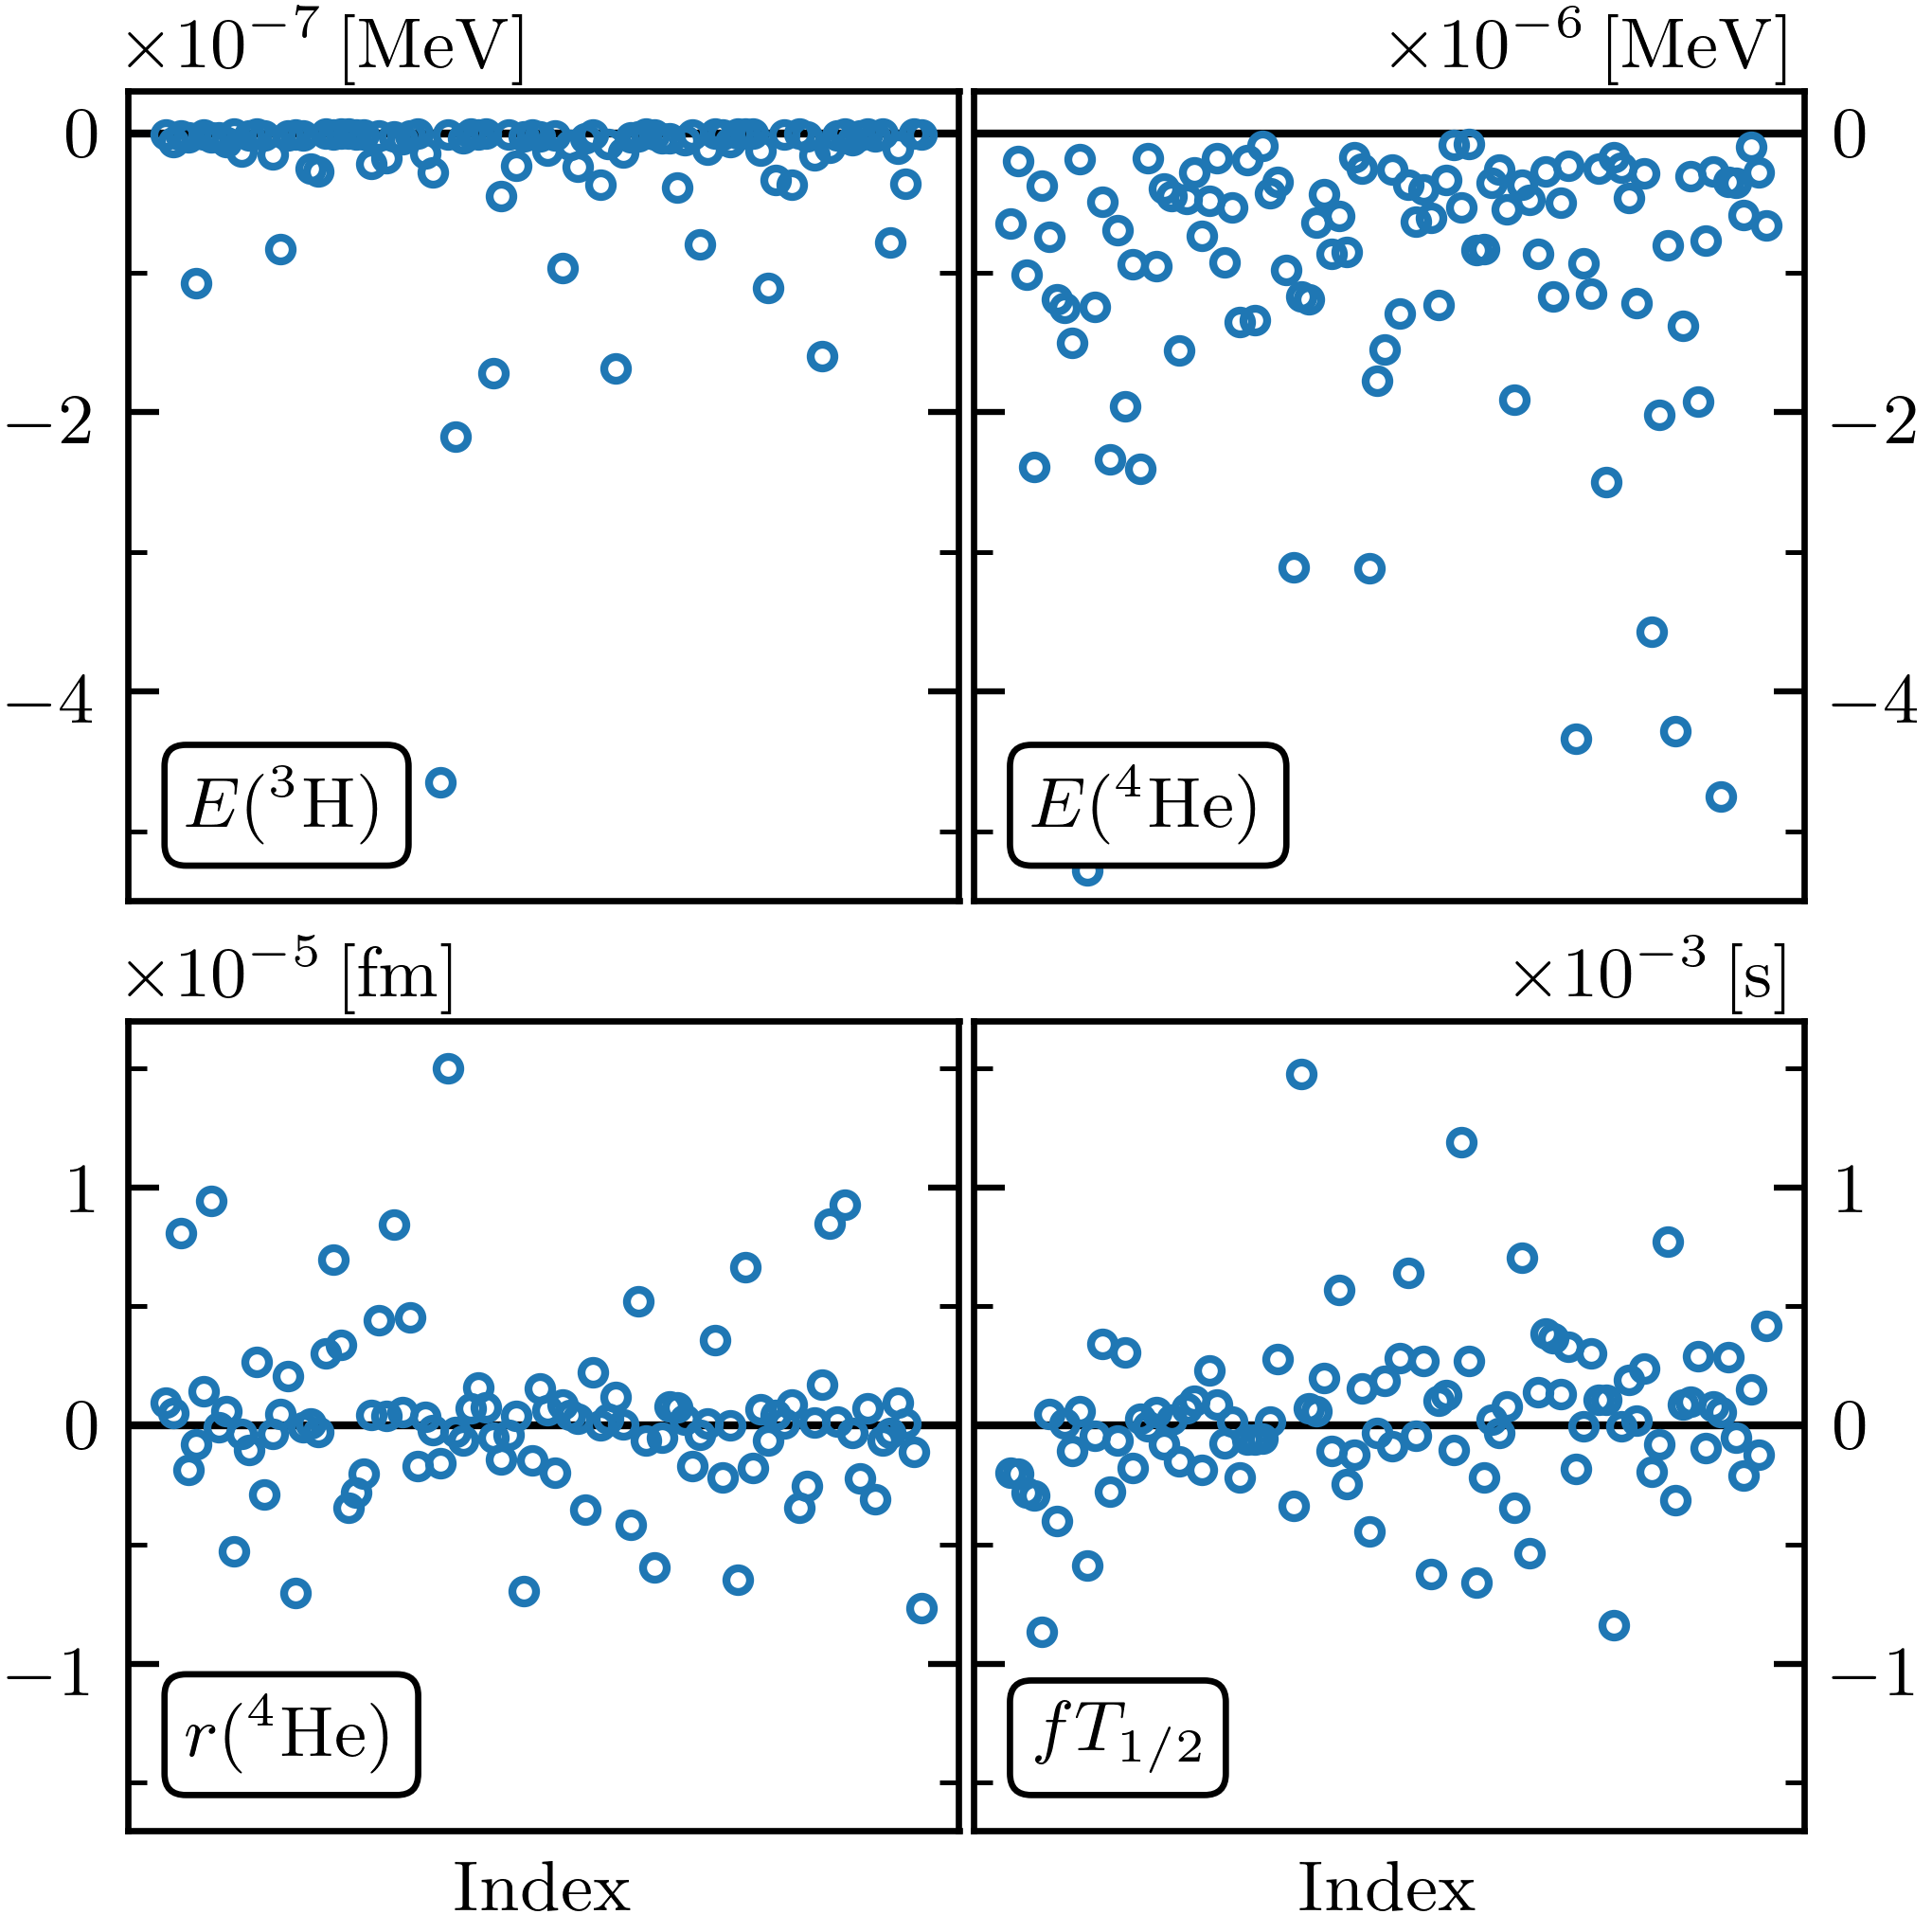
Eigenvector continuation emulators for nuclear observables
Basic idea: a small # of ground-state eigenvectors from a selection of parameter sets is an extremely effective variational basis for other parameter sets. Characteristics: fast and accurate!
Emulator residuals
Wesolowski et al., PRC 104, 064001 (2021)
⁴He energy
EC introduced by Frame et al.
König et al., PLB 810, 135814 (2020)
Emulator doesn’t require specialized calculations!

Slide 27
Model reduction methods for nuclear emulators
Melendez, Drischler, rjf, Garcia, Zhang, J. Phys. G (2022) → many references
BUQEYE Guide to Projection-Based Emulators in Nuclear Physics
Pedagogical guide in Front. Physics; all examples available as interactive, Python code [format: Quarto book]
→
Need: to vary parameters for design, control, optimization, UQ.
Exploit: much information in high-fidelity models is superfluous.
Solution: reduced-order model (ROM) → emulator (fast & accurate™).
General classification of ROMs
Data driven non-intrusive
Model driven intrusive
mixed
Notes:
Takeaways from both papers:
Don’t need a variational approach → Galerkin projection
Quarto book as playground
J. Phys. G: Nucl. Part. Phys. 49 102001 arXiv:2203.05528
Tremendous opportunities for nuclear physics to adapt methods from the MOR literature. In arXiv:2203.05528 we provide pointers to the pointers (MOR reviews).
There are many outside MOR experts that could be consulted/involved in nuclear problems.
”Superfluous” could be redundant or decoupled, for example.
Don’t actually need to say emulator; just reduced-order model (ROM) *is* an emulator.
Data driven uses high-fidelity calculations (Full-Order Model or FOM) as black box: interpolate output but we don’t need to know how it is generated (in the extreme case; we can also build in some knowledge).
Some machine learning approaches in recent literature combine data-driven and model-driven (non-intrusive and intrusive) approaches.
In the MOR -> RBM -> EC figure, the extra boxes denote other MOR approaches.
Parametric MOR is opposed to fixed parameter MOR (which is how it started).

Slide 28
Model reduction methods for nuclear emulators
Melendez, Drischler, rjf, Garcia, Zhang, J. Phys. G (2022) → many references
BUQEYE Guide to Projection-Based Emulators in Nuclear Physics
Pedagogical guide in Front. Physics; all examples available as interactive, Python code [format: Quarto book]
→
Need: to vary parameters for design, control, optimization, UQ.
Exploit: much information in high-fidelity models is superfluous.
Solution: reduced-order model (ROM) → emulator (fast & accurate™).
[Parametric] MOR (model order reduction)
RB (reduced basis) method
…
…
EC (eigenvector continuation)
…
…
E. Bonilla, P. Giuliani et al., Phys. Rev. C 106, 054322
P. Giuliani, K. Godbey et al., arXiv:2209.13039.
Overall message: ROMs from variational principles relate to a vast literature (plus software!) on the Galerkin method, which is even more general. Many alternative implementations are possible and many technical aspects to adapt (e.g., non-affine treatments).
Notes:
Takeaways from both papers:
Don’t need a variational approach → Galerkin projection
Quarto book as playground
J. Phys. G: Nucl. Part. Phys. 49 102001 arXiv:2203.05528
Tremendous opportunities for nuclear physics to adapt methods from the MOR literature. In arXiv:2203.05528 we provide pointers to the pointers (MOR reviews).
There are many outside MOR experts that could be consulted/involved in nuclear problems.
”Superfluous” could be redundant or decoupled, for example.
Don’t actually need to say emulator; just reduced-order model (ROM) *is* an emulator.
Data driven uses high-fidelity calculations (Full-Order Model or FOM) as black box: interpolate output but we don’t need to know how it is generated (in the extreme case; we can also build in some knowledge).
Some machine learning approaches in recent literature combine data-driven and model-driven (non-intrusive and intrusive) approaches.
In the MOR -> RBM -> EC figure, the extra boxes denote other MOR approaches.
Parametric MOR is opposed to fixed parameter MOR (which is how it started).

Slide 29
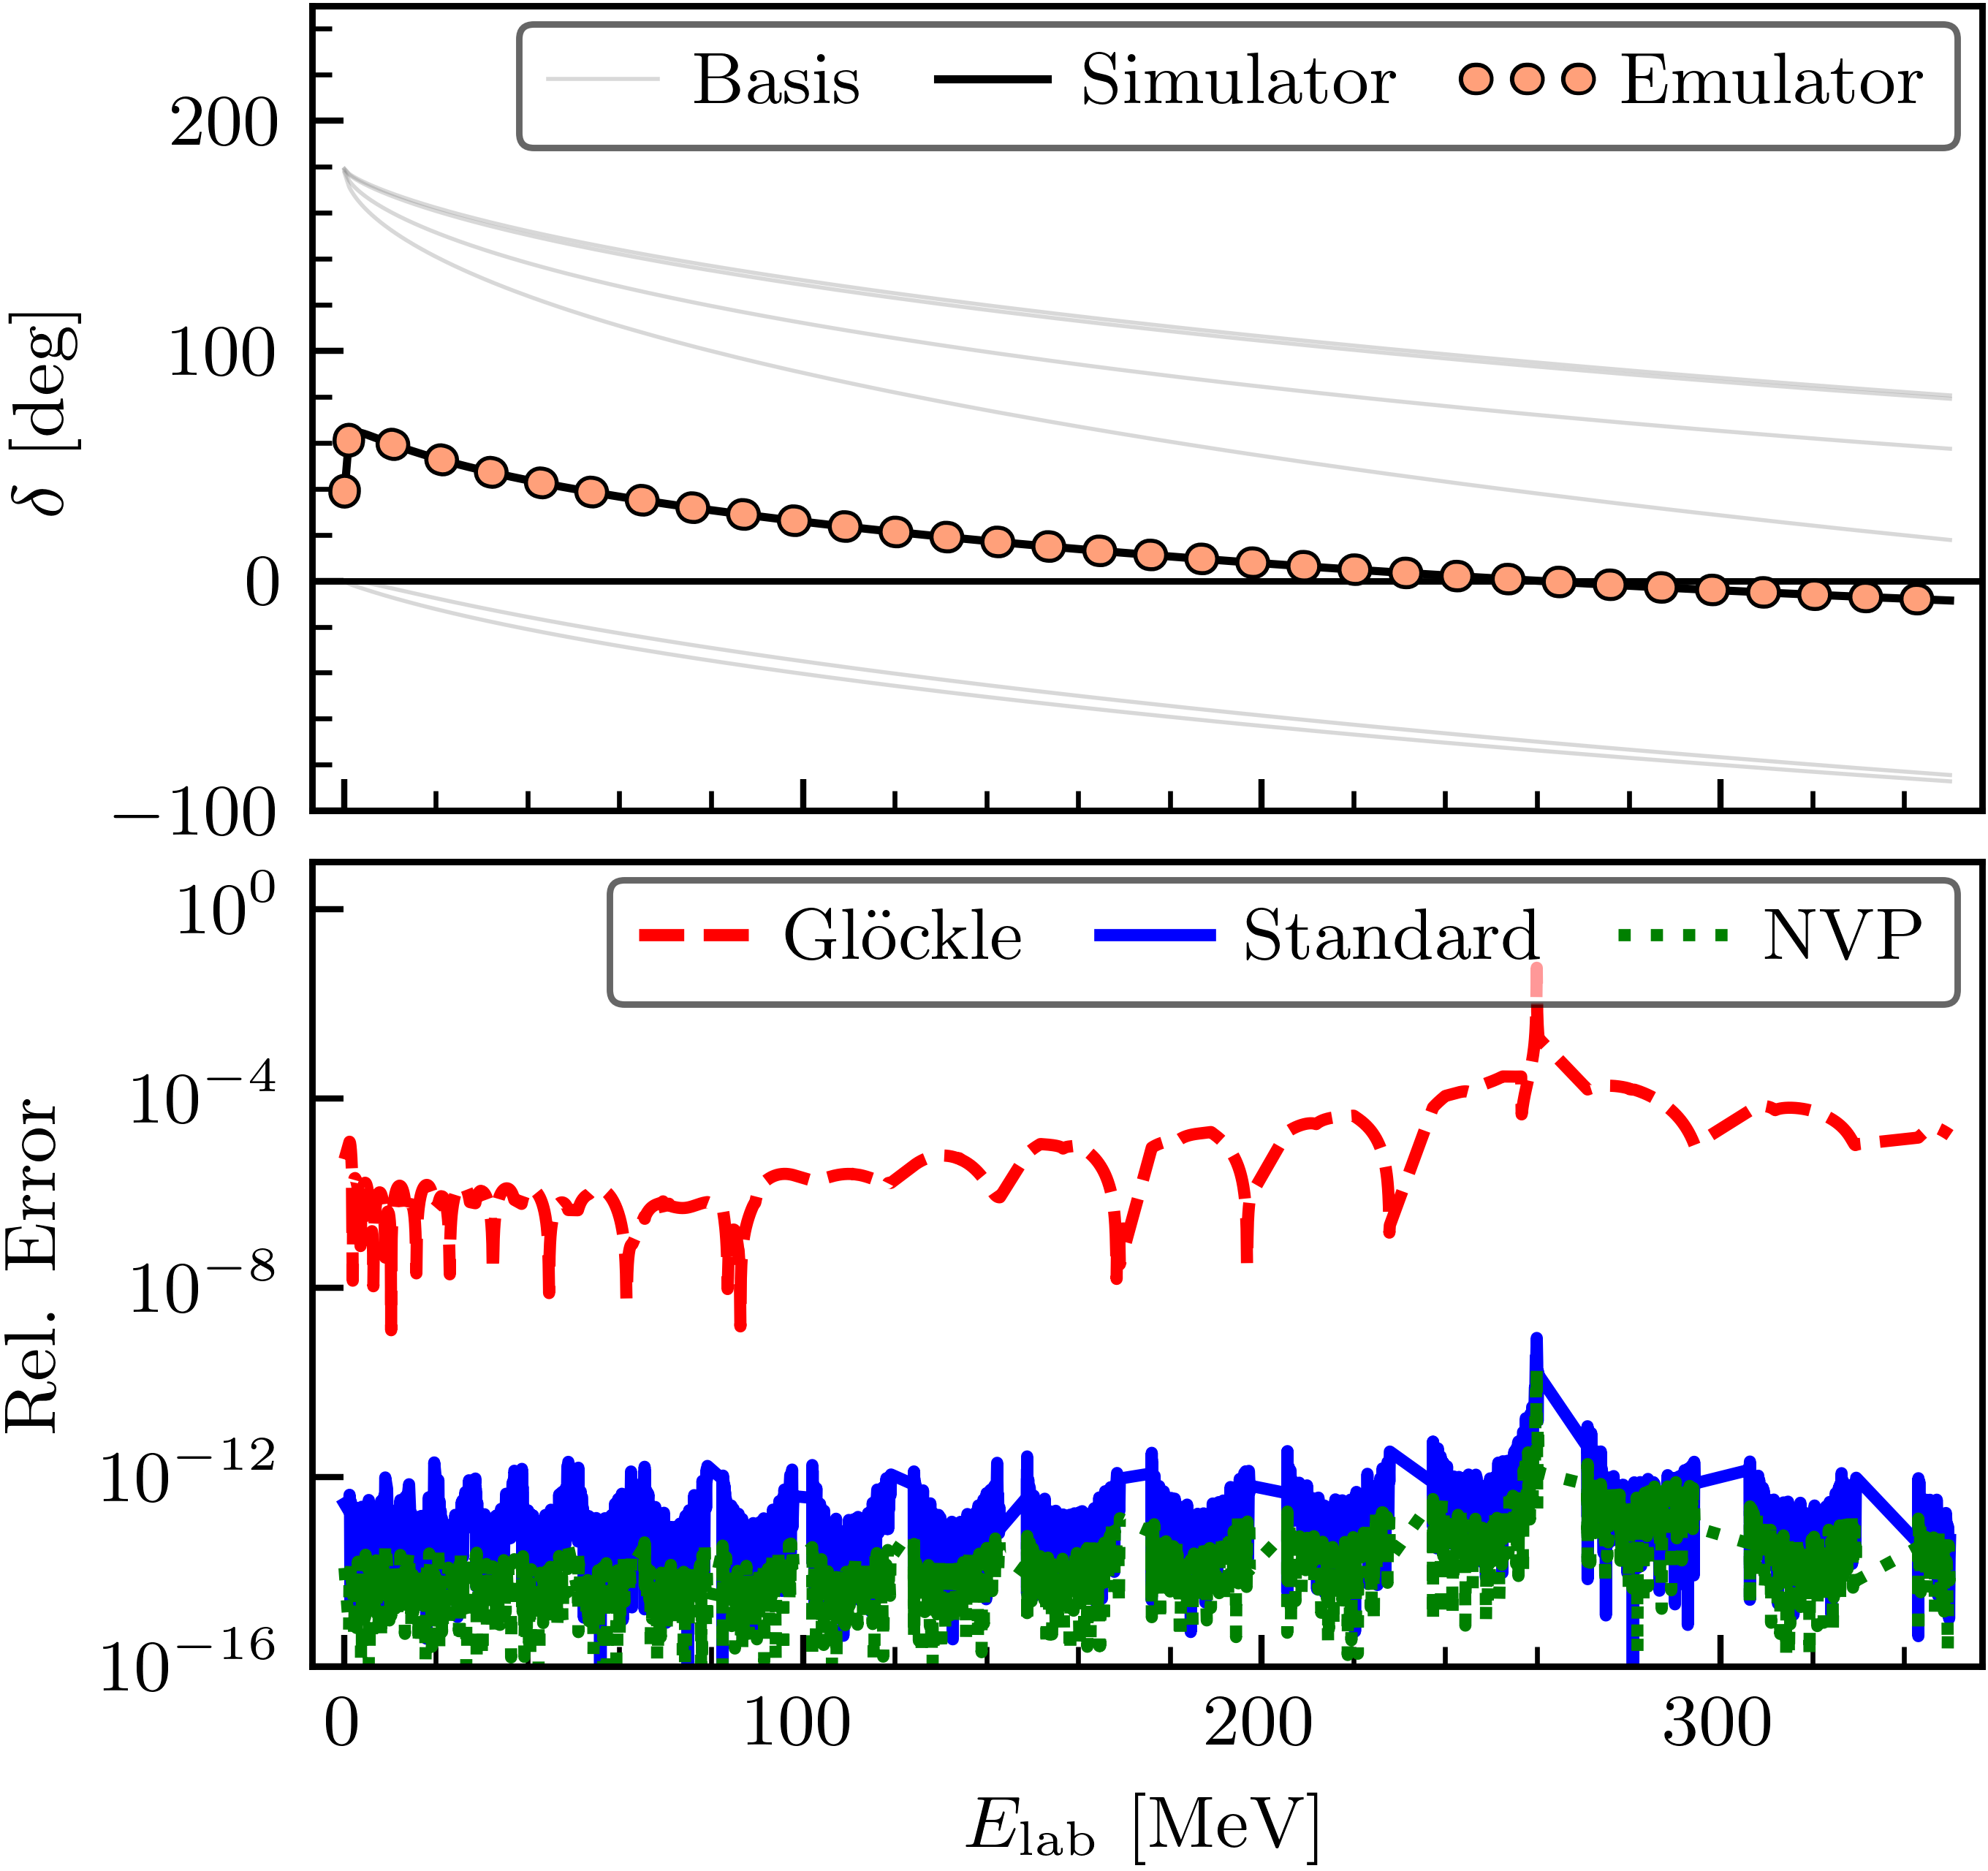
EC-like emulators for NN and 3N scattering
RBM applied to 2-body scattering by rjf et al., PLB (2020) using the Kohn variational principle.
Method improved by Drischler et al., PLB (2021) (e.g., mitigate Kohn anomalies).
Two-body emulation w/o wfs by Melendez et al., PLB (2021) (Newton variational principle).
Latest from Alberto Garcia et al. (arXiv:2301.05093)
NN phase shifts for χEFT potential (SMS)
Here: χEFT SMS potential from Reinert et al.
Partial waves up to
Used LHS to sample 500 parameter sets in an interval of [-5, 5]
Errors essentially negligible
Here: # of basis states = 2 × # LECs
Speed-up is implementation-dependent!
Consistent for
Kohn anomalies mitigated!
Notes:
Developments at top were proof of principle until NVP

Slide 30
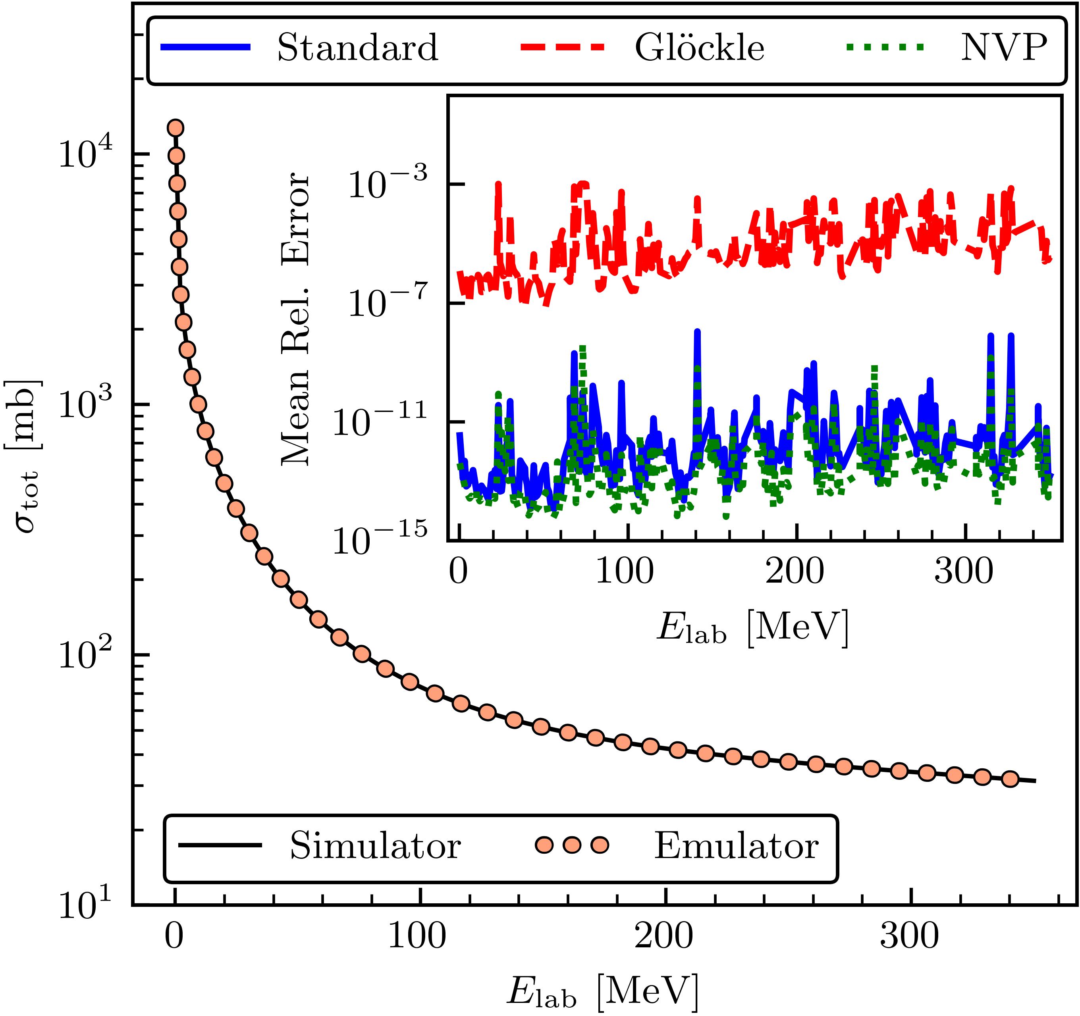
EC emulators for NN and 3N scattering
EC extended to 2-body scattering by rjf et al., PLB (2020) using the Kohn variational principle.
Method improved by Drischler et al., PLB (2021) (e.g., mitigate Kohn anomalies).
Two-body emulation w/o wfs by Melendez et al., PLB (2021) (Newton variational method).
Latest from Alberto Garcia et al. (to be posted soon)
Here: χEFT SMS potential from Reinert et al.
Partial waves up to
Used LHS to sample 500 parameter sets in an interval of [-5, 5]
Errors essentially negligible
Here: # of basis states = 2 × # LECs
Speed-up is implementation-dependent!
Consistent for
NN cross section for χEFT potential (SMS)
Kohn anomalies mitigated!

Slide 31
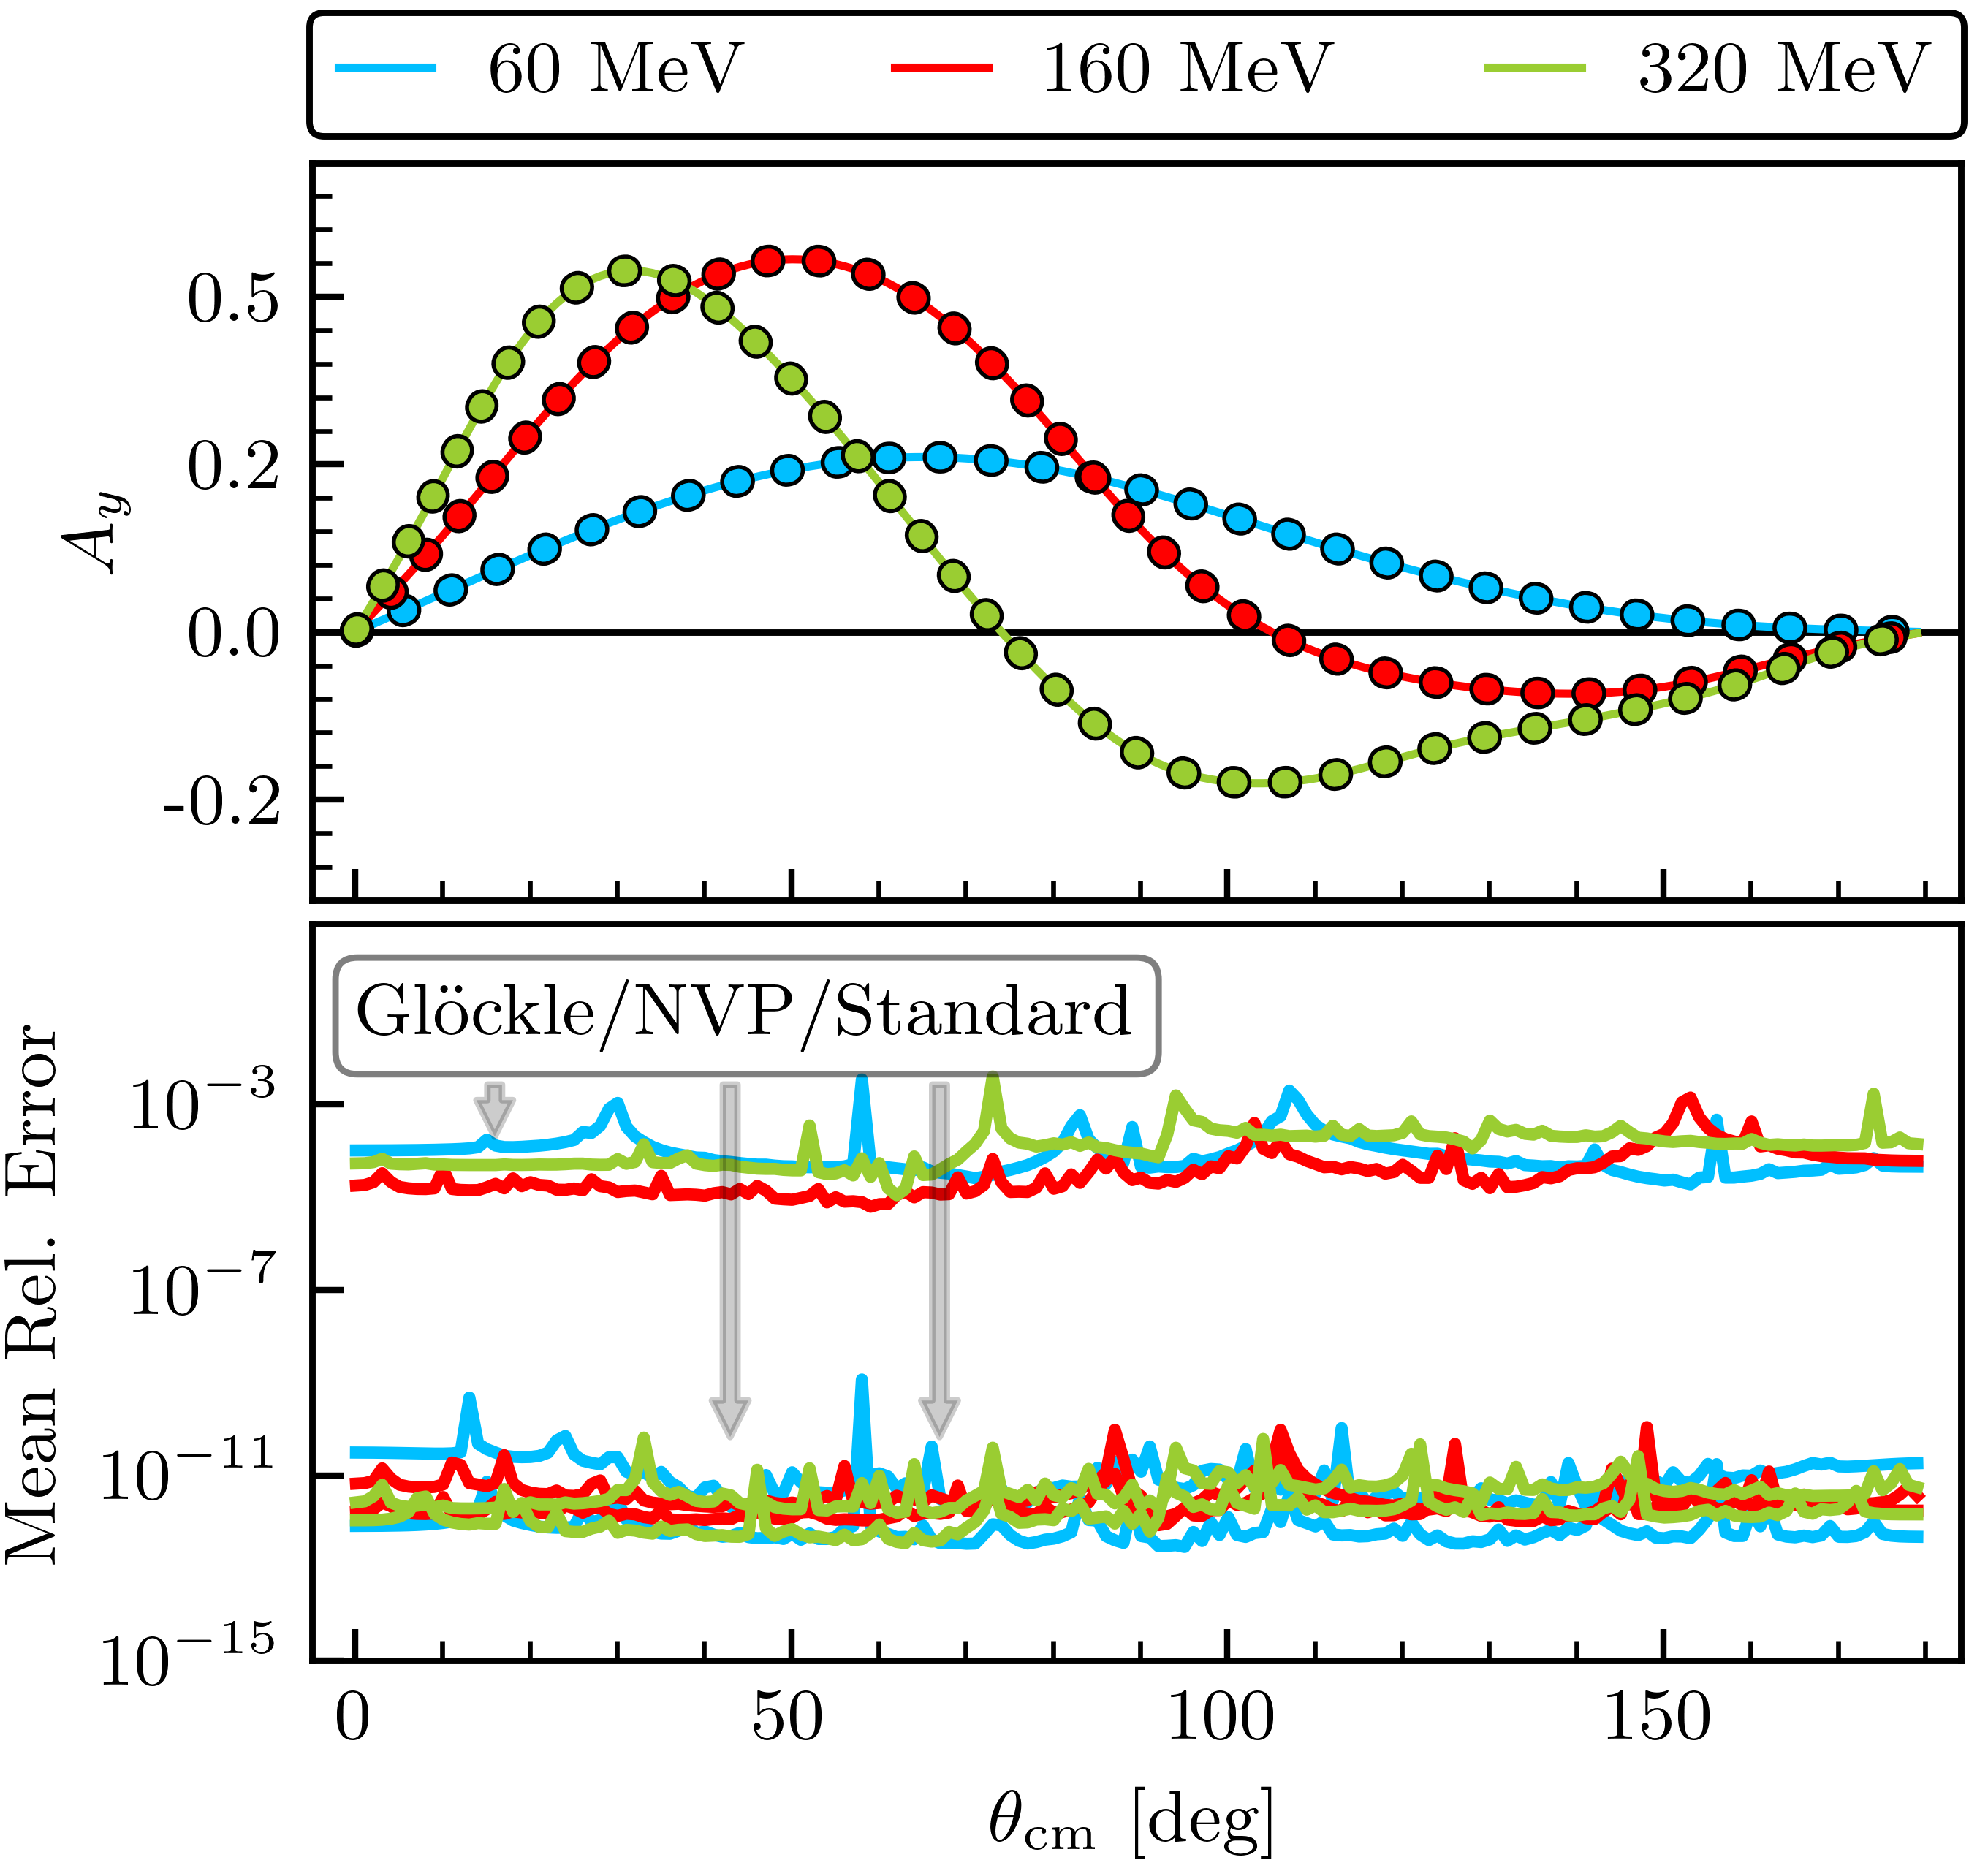
EC emulators for NN and 3N scattering
EC extended to 2-body scattering by rjf et al., PLB (2020) using the Kohn variational principle.
Method improved by Drischler et al., PLB (2021) (e.g., mitigate Kohn anomalies).
Two-body emulation w/o wfs by Melendez et al., PLB (2021) (Newton variational method).
Latest from Alberto Garcia et al. (to be posted soon)
NN analyzing power for χEFT potential (SMS)
Here: χEFT SMS potential from Reinert et al.
Partial waves up to
Used LHS to sample 500 parameter sets in an interval of [-5, 5]
Errors essentially negligible
Here: # of basis states = 2 × # LECs
Speed-up is implementation-dependent!
Consistent for
Kohn anomalies mitigated!

Slide 32
EC emulators for NN and 3N scattering
EC extended to 2-body scattering by rjf et al., PLB (2020) using the Kohn variational principle.
Method improved by Drischler et al., PLB (2021) (e.g., mitigate Kohn anomalies).
Two-body emulation w/o wfs by Melendez et al., PLB (2021) (Newton variational method).
What about 3-body scattering emulators? E.g, for Bayesian χEFT LEC estimation.
→ X. Zhang, rjf proof of principle w/KVP (2022).
NN analyzing power for χEFT potential (SMS)
3-body S-matrix errors for basis size 3, 6, 9, 12, 14 with schematic potential for two test LEC points.
See also Sarkar and Lee, PRL 126 (2021) and PR Res. 4 (2022) and Krakow group for Faddeev emulator, EPJA 57 (2021).

Slide 33
Opportunities at the frontiers of UQ for EFTs
Extend full Bayesian treatments. Do calculations with different regularized Weinberg counting agree within expectations? Analysis of other power countings.
Power counting / EFT truncation model at finite density –> use statistics to uncover power counting? Modeling convergence pattern when there is fine-tuning.
Applications to external currents [e.g., Acharya and Bacca, arxiv:2109.13972]
Exploiting statistical correlations using Bayesian tools, e.g., in nuclear spectra
Using RG for UQ (combine with convergence pattern?)
UQ technologies to develop and apply: model mixing; experimental design, …
Emulators: 3N scattering; infinite matter; new technologies (e.g., active learning)
Making increased use of AI/machine learning
And much more . . . See other talks!!
Notes:
sampling/importance resampling Christian Forssen Front.in Phys. 10 (2022) 1058809

Slide 34
Thank you!

Slide 35
Extra slides

Slide 36
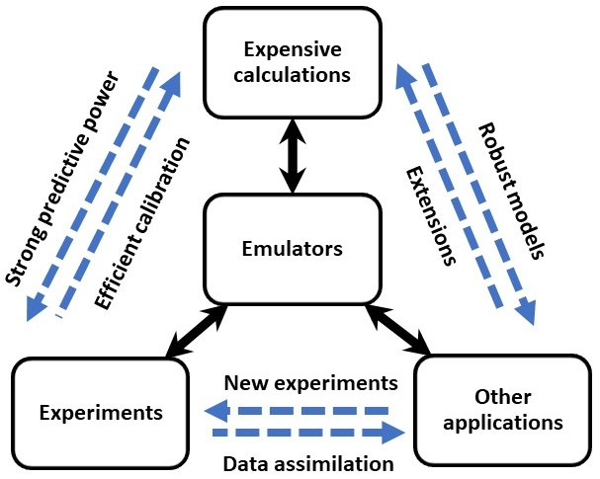
Role of emulators: new workflows for EFT applications
From Xilin Zhang, rjf, Fast emulation of quantum three-body scattering, Phys. Rev. C 105, 064004 (2022).
If you can create fast & accurate™ emulators for observables, you can do calculations without specialized knowledge and expensive resources!

Slide 37



Some of the applications of Bayesian inference
In order of complexity . . .
Forward UQ (e.g., propagate errors using already-sampled posteriors)
Inverse UQ (e.g., parameter estimation including theory errors)
Experimental Design (guide to experiment: which data are most likely to provide the largest information gain; both theory uncertainty and the expected pattern of experimental errors must be considered)

Slide 38
Experimental design: A case study
Maximize benefits – minimize cost (time, money, workforce)
Nucleon polarizabilities from Compton scattering with ChiEFT
[Harald Griesshammer, Judith McGovern, Daniel Phillips, EPJA (2018)]
How do constituents of the nucleon react to external fields?
How to reliably extract proton, neutron, spin polarizabilities?
How to plan effective experiments and test theory?
Experiments: HI𝛾S; A2@MAMI → tension with ChiEFT valid range

Slide 39
Optimizing the design of future Compton scattering experiments
How to plan effective experiments & test theory? What (ω, 𝜃) are most useful for constraining?
Ingredient: Calculate a utility function for sum of variances for each kinematic point on a grid.
Apply to decide on trade-off between different allocations of experimental resources (exploration vs. exploitation).
1-point vs 5-point?
Increase precision or more points?
J. Melendez et al. (in prep.)

Slide 40
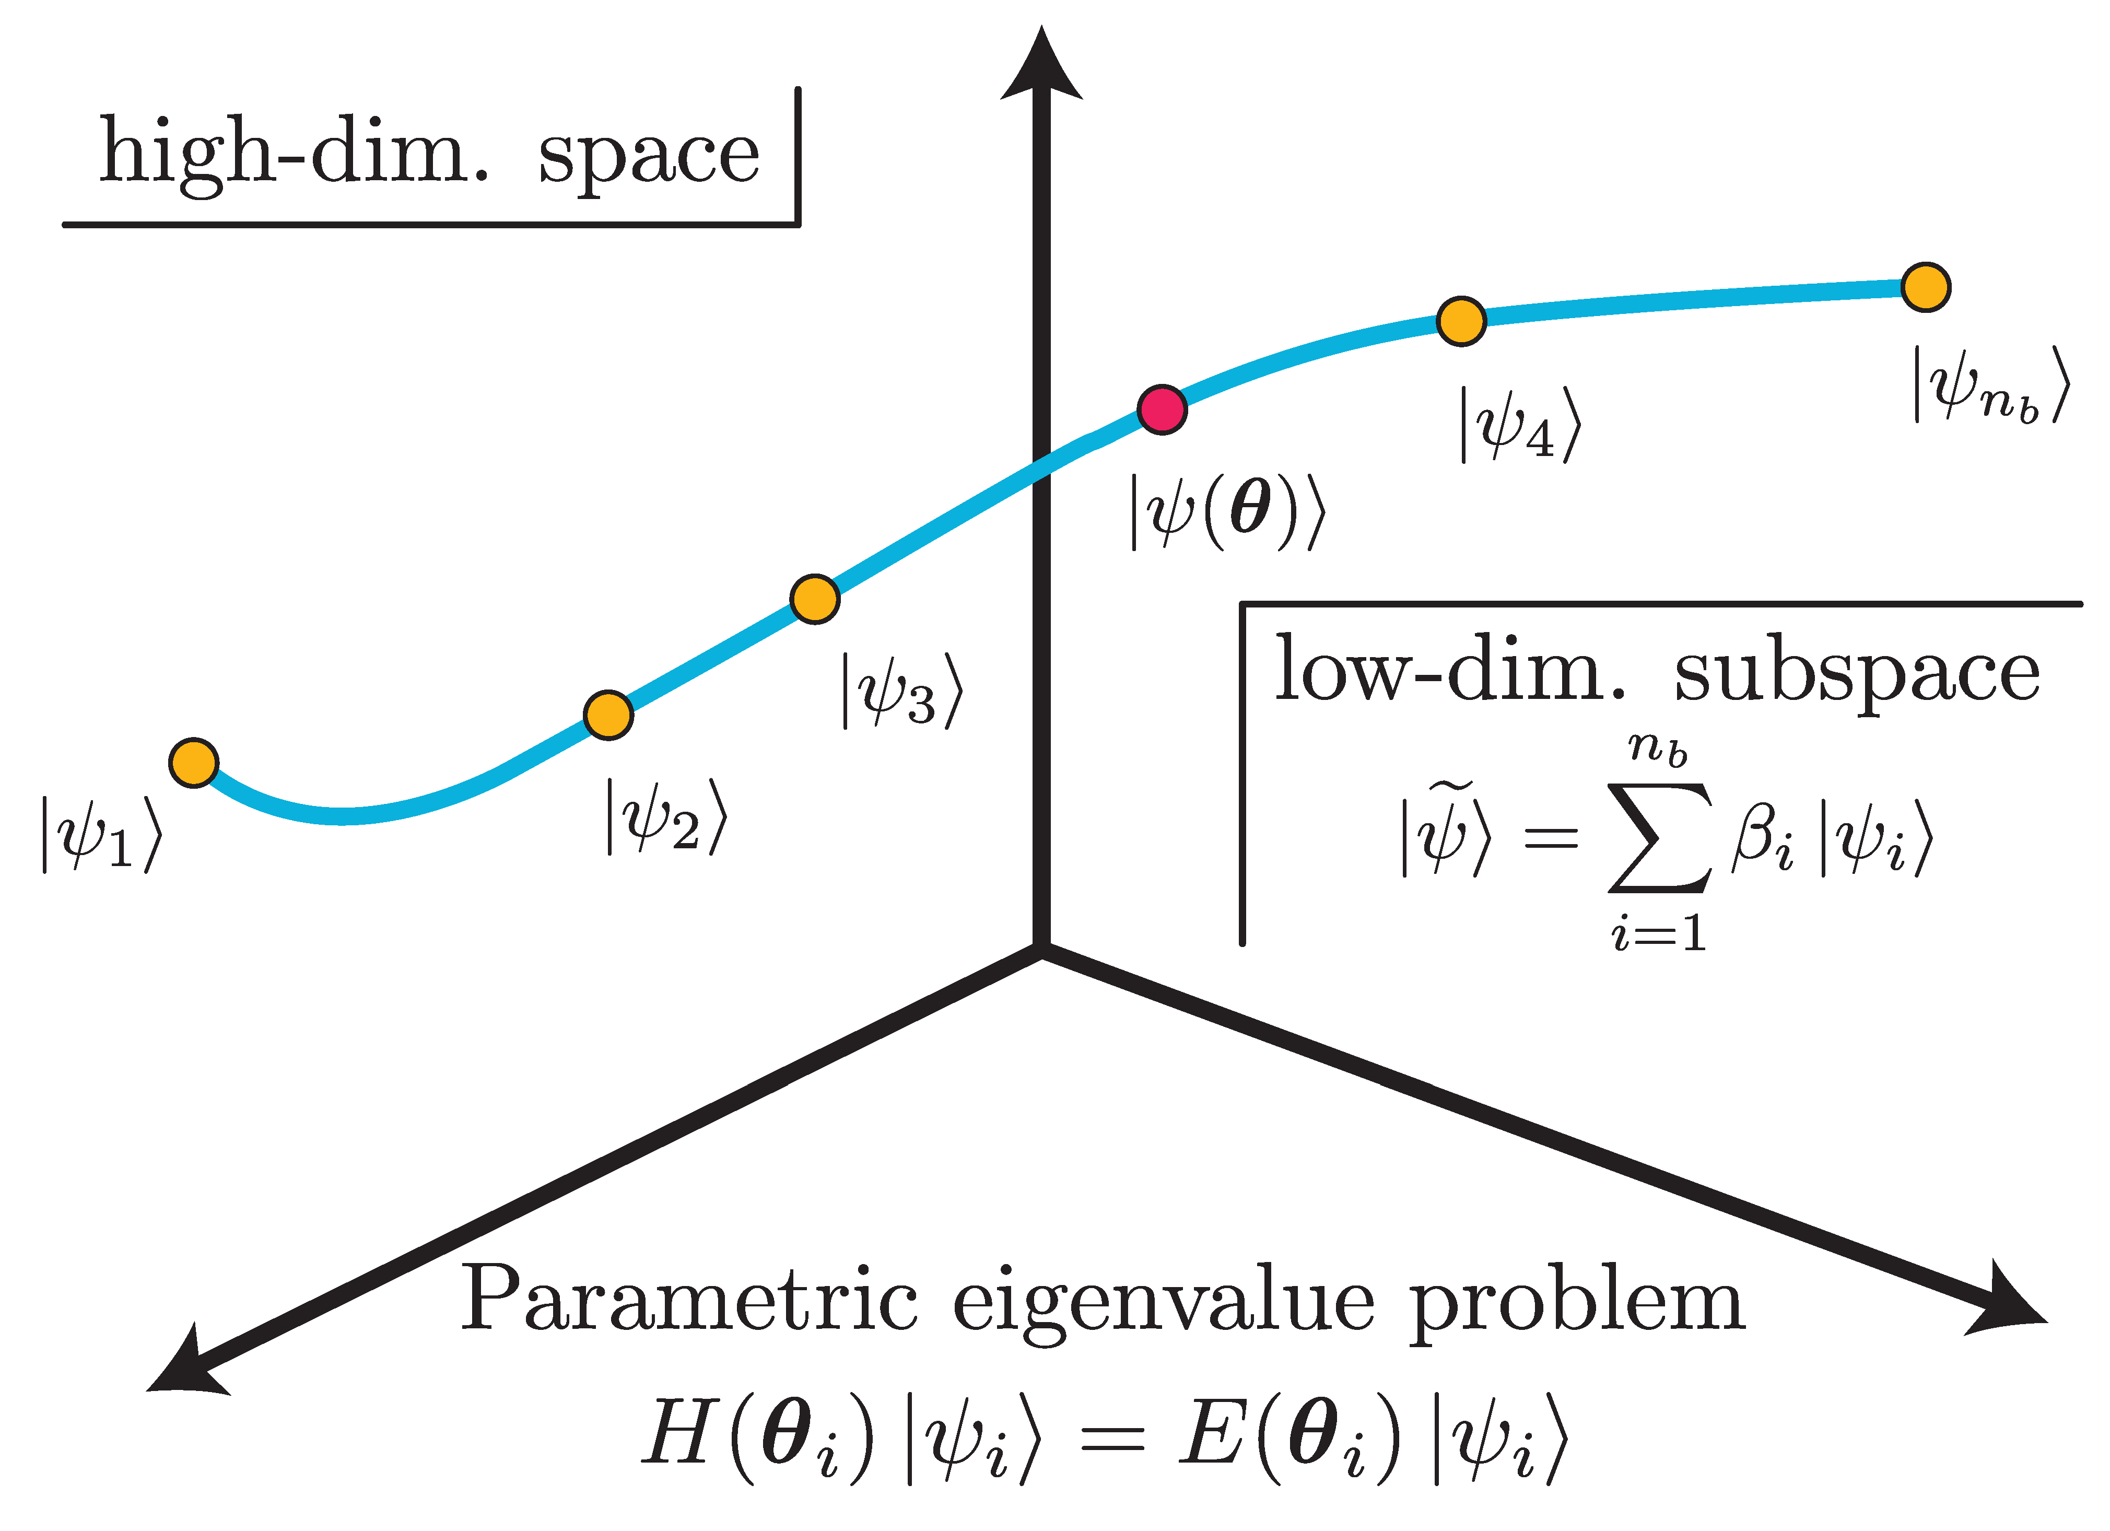
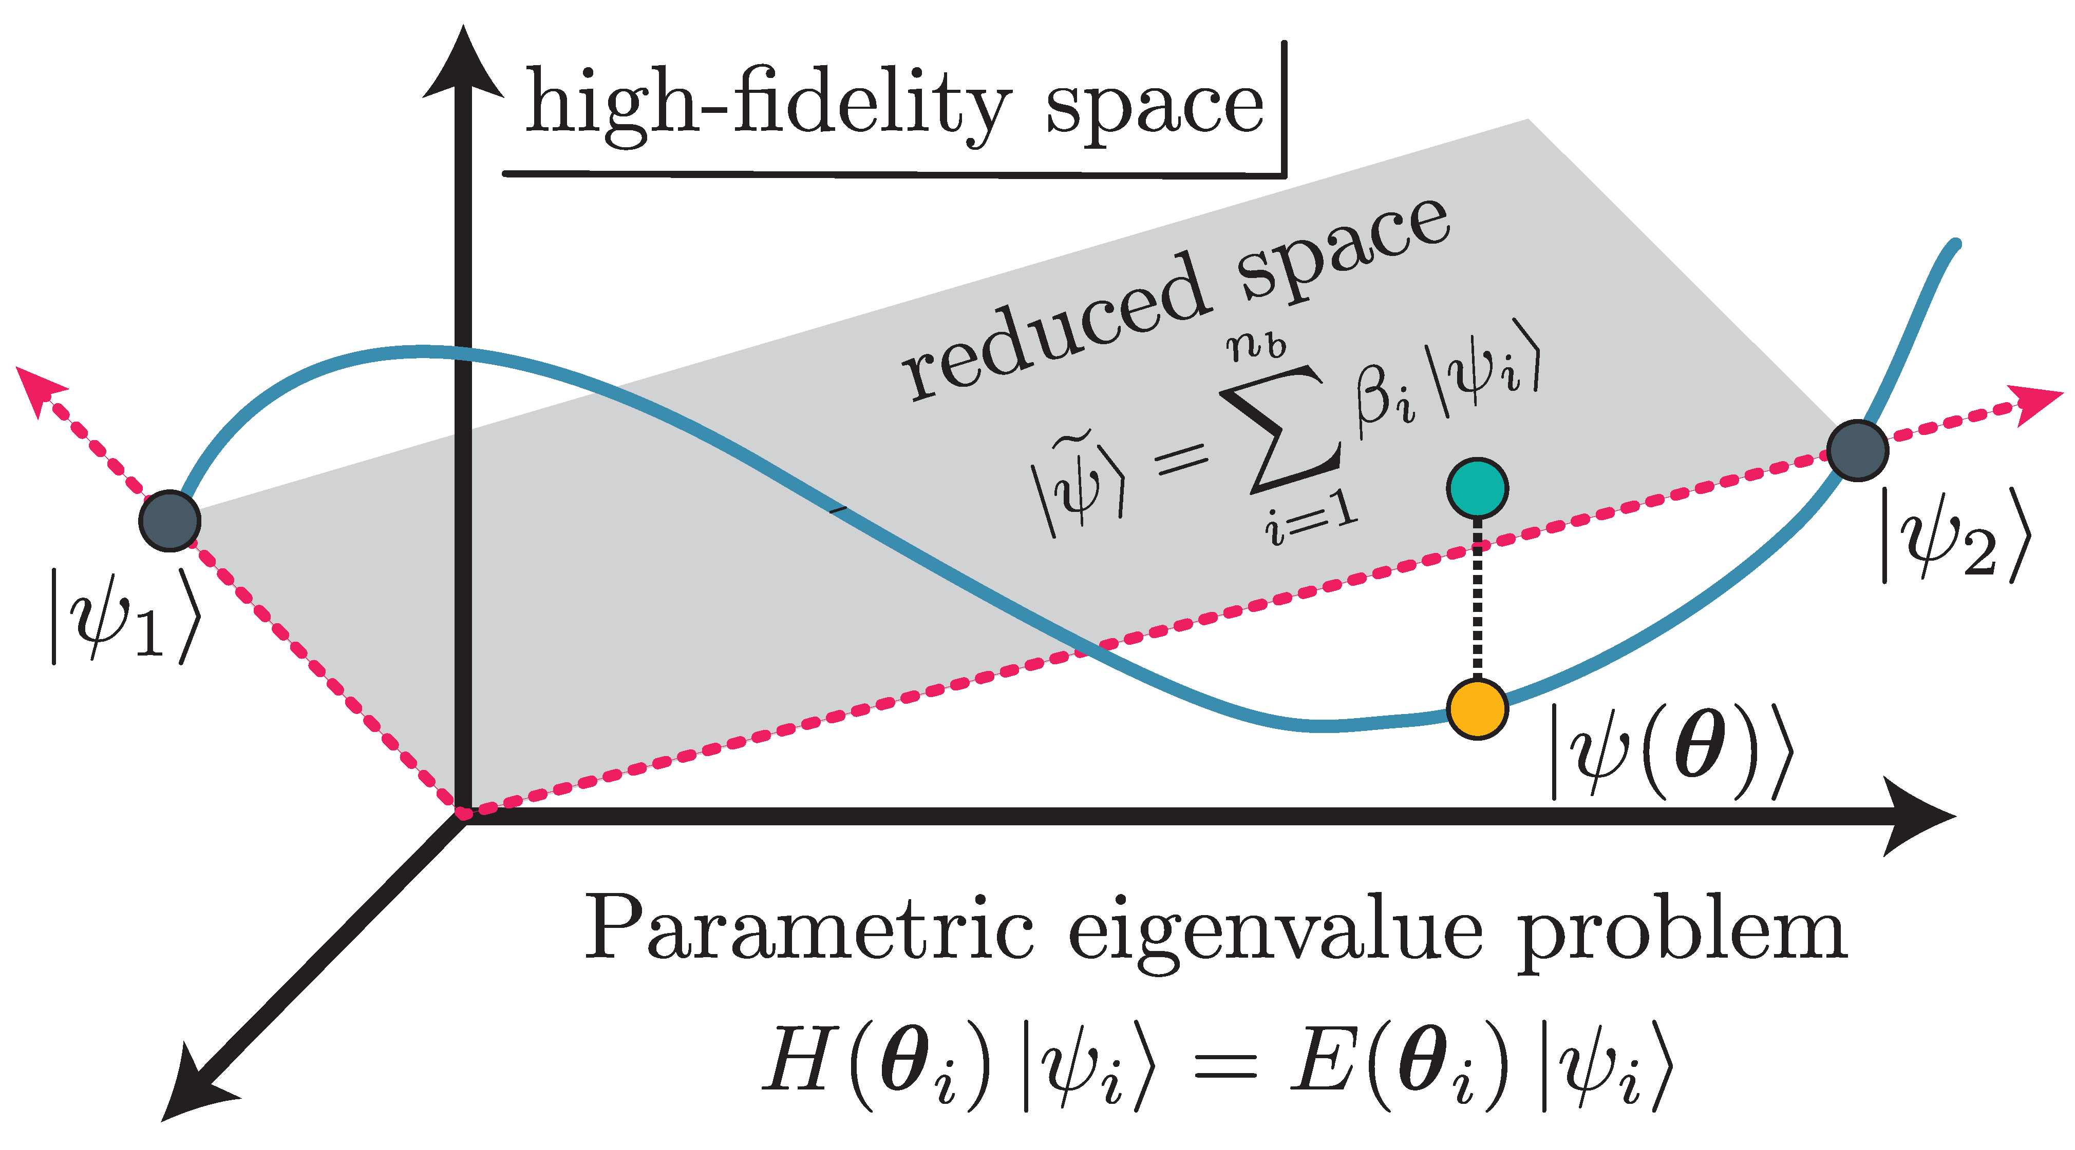
Eigenvector continuation emulators for nuclear observables
Basic idea: a small # of ground-state eigenvectors from a selection of parameter sets is an extremely effective variational basis for other parameter sets. Characteristics: fast and accurate!
Wesolowski et al., PRC 104, 064001 (2021)
⁴He energy
EC introduced by Frame et al.
König et al., PLB 810, 135814 (2020)
Works well for transitions, too!

Slide 41
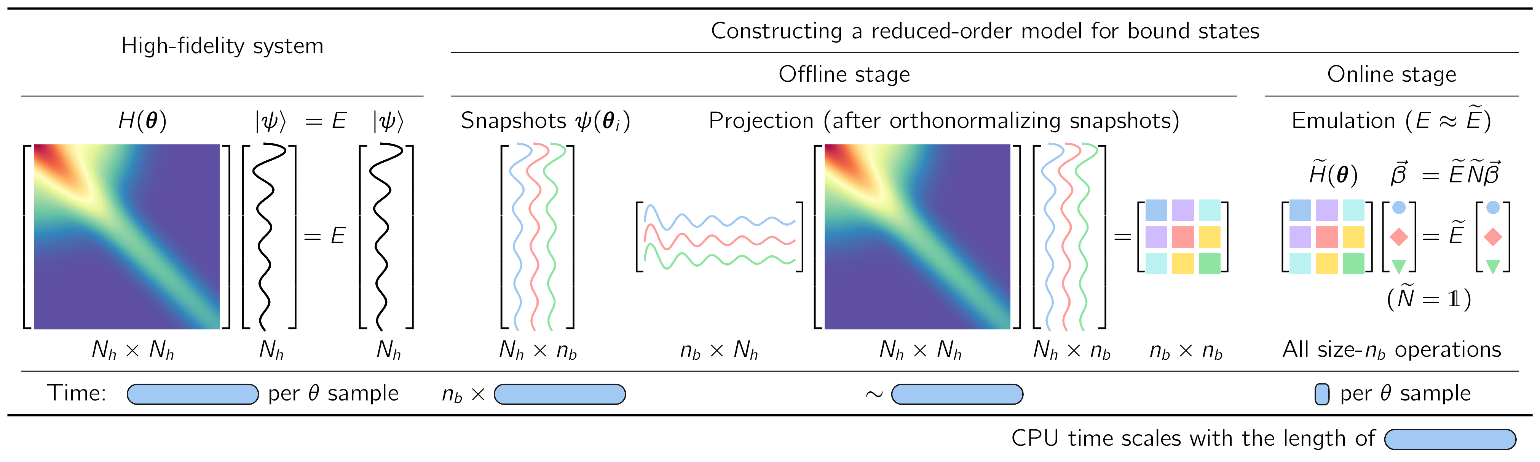
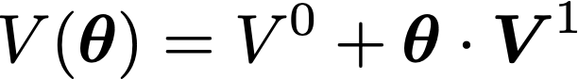
Constructing a reduced-order model (ROM)
Offline stage (pre-calculate):
Parameter sets using a greedy algorithm, Latin-hypercube sampling, etc.
Construct basis using snapshots from high-fidelity system (simulator)
Project high-fidelity system to small-space using snapshots
Exploit affine dependence on the low-energy couplings (LECs):
Online stage:
Make many predictions fast & accurately (e.g., for Bayesian analysis)
J. A. Melendez et al., J. Phys. G 49, 102001 (2022)
E. Bonilla, P. Giuliani et al., Phys. Rev. C 106, 054322
P. Giuliani, K. Godbey et al., arXiv:2209.13039.
C. Drischler et al., Quarto + arXiv:2212.04912
Notes:
Contains all the relevant information needed for the calculation, while being much cheaper to evaluate.
Workflow of how to construct a snapshot-based reduced-order model.
From that high-fidelity system we extract snapshots.
With snapshots, we project the high-fidelity solution.
All offline.
Predictions in online stage.
Faster than their high-fidelity counterpart.

Slide 42
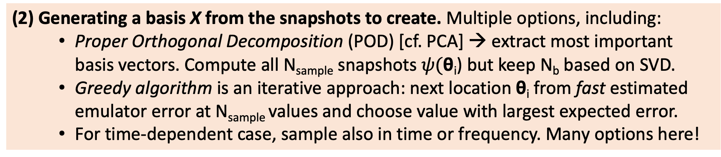
Parametric MOR emulator workflow
Bird’s eye view but still for projection-based PMOR only (i.e., not an exhaustive set!)
Sampling across range of parameters θ for N_{sample} candidate snapshots → {θ_{i}}
E.g., space-filling design (like latin hypercube) or center near emulated values.
Want N_{b} ≤ N_{sample} snapshots; locate wisely based on basis construction method.
(2) Generating a basis X from the snapshots to create. Multiple options, including:
Proper Orthogonal Decomposition (POD) [cf. PCA] → extract most important basis vectors. Compute all N_{sample} snapshots $ψ(\text{θ}$_{i}) but keep N_{b} based on SVD.
Greedy algorithm is an iterative approach: next location $\text{θ}$_{i} from fast estimated emulator error at N_{sample} values and choose value with largest expected error.
For time-dependent case, sample also in time or frequency. Many options here!
(3) Construct the reduced system. Single basis X or multiple bases across θ
Linear system and affine operators → projecting to single basis works well.
If non-linear or non-affine → hyper-reduction approaches: e.g., empirical interpolation method EIM or DEIM, which finds an affine (separable) expansion.
Notes:
See refs. In arXiv:2203.05528.
* Hyper-reduction trade accuracy or speed.
* “Approximate then project” first approximates the non-affine or non-linear operators as a linear combination of affine operators (coefficients to be determined) with operators that can be projected via X up front (offline). These include the (discrete) empirical interpolation methods [D]EIM and the gappy-POD method.
“Project then approximate” attempt to interpolate basis X or projected operators \tilde H = X^\dagger H X
* Also non-intrusive meds, including ML to approximate basis coefficient \vec\beta or projected operators \tilde H.

Slide 43

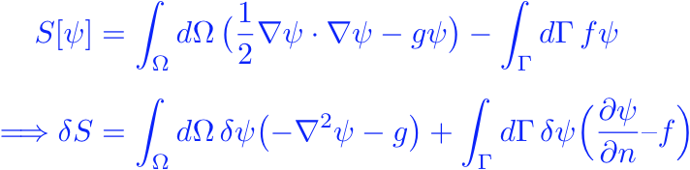
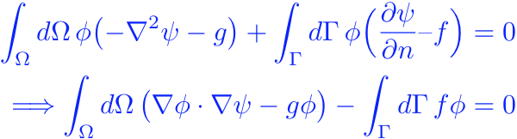
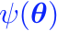
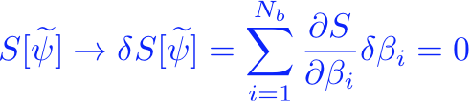
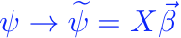
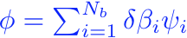



Variational and Galerkin emulators by concrete example
Emulator → find optimal cheaply online
E.g., Poisson equation with Neumann BCs → with
Variational (Ritz)
Ritz-Galerkin
Weak formulation rather than variational → multiply each equation by test function
So δS = 0 gives the Poisson eq. and BCs. Emulate :
→ N_{b} equations for
Assert holds for and
If linear (as here)
→
If affine g($\text{θ}\text{)}$, f($\text{θ}\text{)}$ → calculate high-fidelity offline. If nonlinear or nonaffine → hyper-reduction, etc.
Same result as variational here (but Galerkin is more general). If φ_{i} ≠ ψ_{i}, then Petrov-Galerkin.
Notes:
To make Poisson nonlinear, add term like \psi^2 or \sinh(\psi).
An affine g(\theta) example would be a sum of Gaussians with fixed widths. A nonaffine g(\theta) example would be a (sum of) Gaussian(s) with a parameter for the width. (Or a Gaussian source with parameters for the center.)
“The empirical interpolation method (EIM) is a general tool to deal with nonaffine parameter dependence and nonlinear problems.” Variations like DEIM (D is for “discrete”).
For Galerkin we are minimizing the *residual*.
\psi(\thetavec) \approx \tpsi(\thetavec) = X\vec\beta_*, \ \ X \equiv[\psi_1\, \psi_2\, \cdots\, \psi_{N_b}]
\psi(\thetavec)
\tilde\psi(\thetavec) \equiv X\vec\beta_*, \ \ X \equiv[\psi_1\, \psi_2\, \cdots\, \psi_{N_b}]
\bm{\vec\beta_*}
[-\nabla^2\psi = g(\thetavec)]_\Omega \quad [\frac{\partial\psi}{\partial n} = f(\thetavec)]_\Gamma
[-\nabla^2\psi = g(\thetavec)]_\Omega \qquad\quad [\frac{\partial\psi}{\partial n} = f(\thetavec)]_\Gamma
S[\psi] &= \int_\Omega d\Omega\, \bigl(\frac12 \nabla\psi\cdot\nabla\psi - g\psi\bigr) - \int_\Gamma d\Gamma\, f\psi \\[5pt]
\Longrightarrow\delta S &= \Bigl[\int_\Omega d\Omega\, \bigl(-\nabla^2\psi - g\bigr) + \int_\Gamma d\Gamma\, \Bigl(\frac{\delta\psi}{\delta n} - f\Bigr) \Bigr] \delta\psi
S[\tpsi] \rightarrow \delta S[\tpsi] = \sum_{i=1}^{N_b} \frac{\partial S}{\partial\beta_i} \delta\beta_i = 0
\tpsi(\thetavec) \equiv X\vec\beta_*, \ \ X \equiv[\psi_1\, \psi_2\, \cdots\, \psi_{N_b}]
S[\psi] &= \int_\Omega d\Omega\, \bigl(\frac12 \nabla\psi\cdot\nabla\psi - g\psi\bigr) - \int_\Gamma d\Gamma\, f\psi \\[5pt]
\Longrightarrow\delta S &= \int_\Omega d\Omega\, \delta\psi\bigl(-\nabla^2\psi - g\bigr) + \int_\Gamma d\Gamma\, \delta\psi\Bigl(\frac{\partial\psi}{\partial n} – f \Bigr)
{\red\widetilde A \vec\beta_* = \vec g + \vec f}, \quad &
\widetilde A_{ij} = (\nabla\psi_i)\cdot(\nabla\psi_j), \\ g_i = g\cdot\psi_i,&\quad f_i=f\cdot \psi_i
\int_\Omega d\Omega\, \phi\bigl(-\nabla^2\psi - g\bigr) + \int_\Gamma d\Gamma\, \phi\Bigl(\frac{\partial\psi}{\partial n} – f \Bigr) &= 0 \\
\Longrightarrow \int_\Omega d\Omega\, \bigl( \nabla\phi\cdot\nabla\psi - g\phi\bigr) - \int_\Gamma d\Gamma\, f\phi &= 0
\int_\Omega d\Omega\, \delta\beta_i\bigl(\nabla\psi_i\cdot\nabla\psi_j\beta_j - g\psi_i\bigr) - \int_\Gamma d\Gamma\, \delta\beta_if\psi_i = 0
\psi \rightarrow \tpsi = X \vec\beta

Slide 44
Some model reduction methods in context
Reduced Basis method (1980) widely used to emulate PDEs in reduced-order approach. Specific choices in MOR framework:
Parameter set chosen using greedy algorithm (or POD)
Single basis X constructed from snapshots
RB model built from global basis projection
Parametric MOR
RB method
EC
Eigenvector continuation (EC) is a particular implementation of the RB method → parametric reduced-order model for an eigenvalue problem (lots of prior art)
Global basis constructed with snapshot-based POD approach
“Active learning” by Sarkar and Lee adds greedy sampling algorithm for next θ_{i}
Summary: general features of good reduced-order emulators
System dependent → works best when QOI lies in low-D manifold and operations on ψ can be avoided during online phase
Relative smoothness of parameter dependence
Affine parameter dependence (or effective hyper-reduction or other approach)
Notes:
“These construction methods are divided into those that use global information over the parameter space, and those that use local information combined with an interpolation method. “
Is “global basis” clear here? Global means global over the parameter space. See survey_of_model_reduction.pdf (SOMR) section 2.3 and later. The alternative is local bases, which means that each parameter has a basis.
“For the more general case where the parametric dependence is nonaffine, typically one must introduce an approximation strategy in order to avoid costly O(n) evaluations in forming the reduced matrices for each different parameter value—though some parametric model reduction methods do not require affine parameter dependence; see section 4. In some cases, the low-order terms of a Taylor series expansion provide a suitable approximate affine decomposition of the system matrices [62, 112, 218]. A more general approach that has been used successfully for nonlinear model reduction is selective sampling of the nonlinear terms combined with interpolation among these samples to recover an approximate nonlinear evaluation. Among this class of methods, the missing point estimation [19] and Gauss Newton with approximated tensors (GNAT) [66] methods both build upon the gappy POD interpolation method [87]; the empirical interpolation method (EIM) [26] and its discrete variant, the discrete empirical interpolation method (DEIM) [67], conduct interpolation on a low-dimensional basis for the nonlinear term. The EIM has been recently extended to the case where A(p) represents a PDE operator [77]. “
“This section presents three different methods for deriving the reduced basis matrices V and W: rational interpolation methods, balanced truncation, and proper orthogonal decomposition (POD). “
From Quarteroni et al text:
“The strategy adopted in RB methods consists in the projection of the high-fidelity problem upon a subspace made of specially selected basis functions, representing a set of high-fidelity solutions corresponding to suitably chosen parameters.”

Slide 45
Reduced-order model (ROM) for scattering w/ NVP
LS equation:
Training set:
K-matrix formulation:
Newton variational principle (NVP):
Implementation:
Snapshots
Basis weights
Linear algebra in small-space!
J. A. Melendez et al., Phys. Lett. B 821, 136608 (2021)
Alberto Garcia
Notes:
Emulates the Lippmann Schwinger equation.
Not limited to K
Newton Variational Principle.
K tilde → trial scattering matrix.
Combination is stationary.
K_i are the exact solutions (aka snapshots)
Linear algebra problem in small parameter space.

Slide 46




Reduced-order model (ROM) for scattering w/ KVP
Hamiltonian:
Training set:
K-matrix formulation:
Generalized Kohn variational principle (KVP):
Here momentum space implementation.
For coordinate space implementation:
Furnstahl et al., Phys. Lett. B 809, 135719 (2020)
Drischler et al., Phys. Lett. B 823, 136777 (2021)
Snapshots
Implementation:
Basis weights
Linear algebra in small-space!
Alberto Garcia
Notes:
Wave function emulator.
Generalized Kohn variational principle, with psi tilde as our trial wave function
Bold u are non-singular matrices used to parametrize the asymptotic boundary condition
Psi tilde → trial wave function
Stationary.
Basis → Exact scattering wave functions (snapshots).
Purely linear algebra-based
Representation-independent.

Slide 47



Anomalies example
Kohn anomalies mitigated!
Mesh-induced spikes in high-fidelity LS equation detected and removed
Anomaly
Numerical spikes
Alberto Garcia
Notes:
Other spikes numerical issues with simulator.

Slide 48












Correlated theory errors for EOS properties
C. Drischler et al. (in prep.)
at 0.17 ± 0.01 fm³
Correlated GP treatment gives better estimates for truncation errors and clean propagation of uncertainties to derived quantities.

